Slide 1
How to create a blog using wix

Slide 2
4
YOU TYPE IN WWW.WIX.COM TO GET TO THE WEBISTE HOME PAGE. WHERE YOU NOW CLICK ON SIGN IN TO OPEN A WIX ACCOUNT

Slide 3
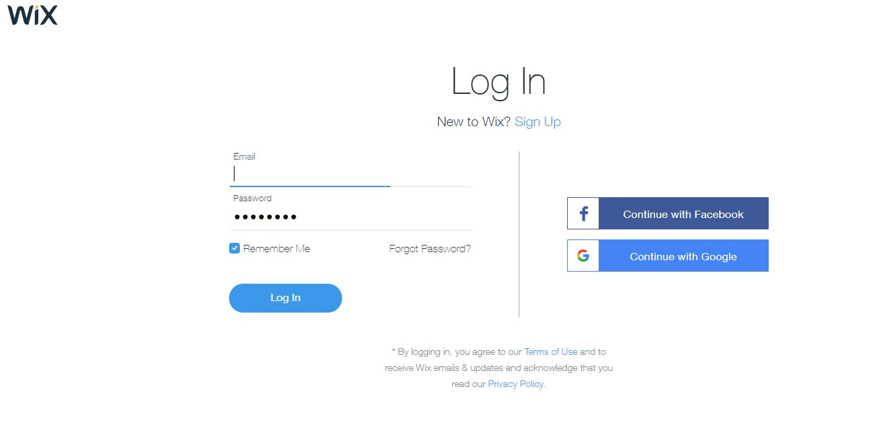
YOU HAVE TO REGISTER OR SIGN UP
SO YOU CLICK ON THE SIGN UP OPTION.

Slide 4
INPUT YOUR DETAILS AND CLICK ON SIGN UP

Slide 5
CLICK ON LET’S DO IT OR SKIP

Slide 6
CLICK ON CHOOSE A TEMPLATE TO SELECT THE TEMPLATE YOU WANT TO USE FOR YOUR WIX WEBSITE.

Slide 7
IN THIS SECTION YOU SELECT MYSITES
BECAUSE YO DON’T HAVE A SITE YET AND YOU CANT SELECT TEMPLATE FOR NO SITE.

Slide 8
NOW YOU CLICK ON “CREATENEWSITE”

Slide 9
HERE YOU SELECT THE KIND OF WEBSITE YOU WANT TO CREATE.?
IN WHICH I CHOSE BLOG

Slide 10
CLICK ON TEMPLATE TO SELECT TEMPLATE FOR YOUR BLOG SITE.

Slide 11
HERE YOU SELECT YOUR PREFERED TEMPLATE TYPE YOU LOVE.

Slide 12
THIS IS THE PAGE WHERE YOU GET TO EDIT YOUR WIX SITE PAGE

Slide 13
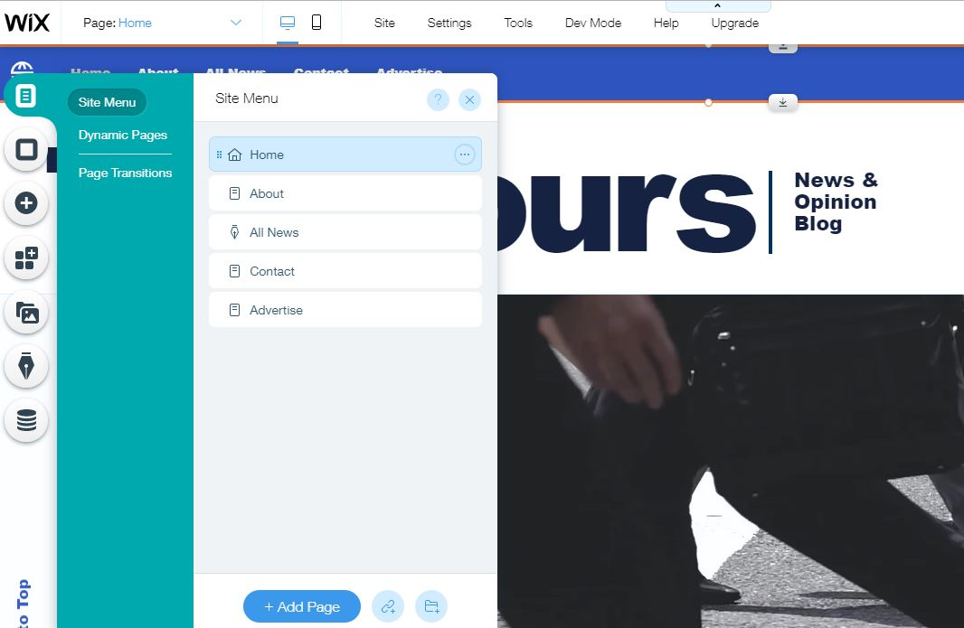
THIS IS THE MENUS AND PAGES OPTION. USE TO SELECT THE DIFFERENT PAGES AND MENUS ON ALL THE WEBPAGES IN YOUR WIX SITE.

Slide 14
THE PAGE BACKGROUND OPTION CAN BE USED TO CHANGE BACKGROUND IMAGES IN ALL THE WEBPAGES IN THE WIX SITE.

Slide 15
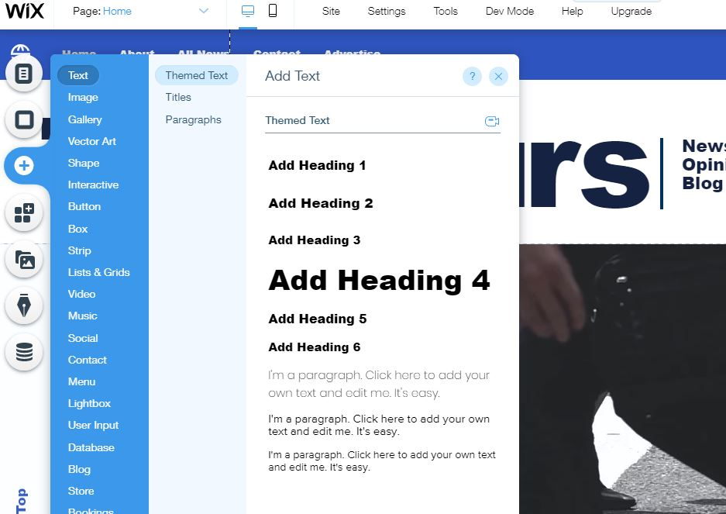
THIS OPTION ALLOWS YOU TO ADD ANY TOOL IN THE WEBSITES.

Slide 16
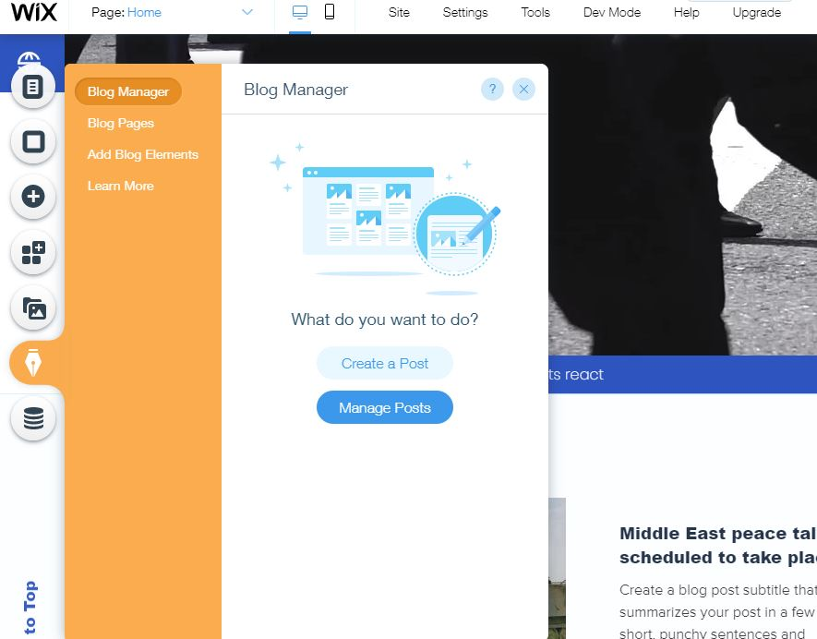
THIS OPTION ALLOWS YOU TO MANAGE YOUR BLOG POSTS.

Slide 17
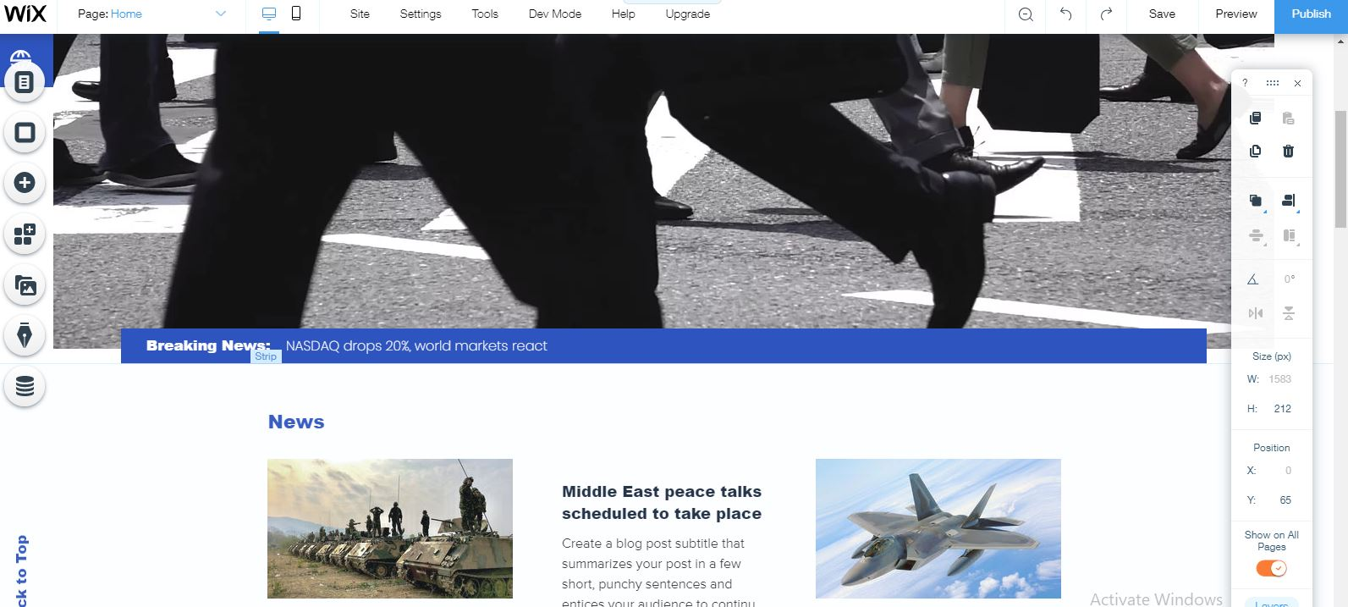
WHEN YOU ARE THROUGH WITH EDITING YOUR WIX SITE, YOU CAN THEN CHOOSE TO PUBLISH YOUR SITE.

Slide 18
NOW TO CREATE A POST YOU GO BACK TO YOUR BLOG TAB OPTION AND SELECT IT TO BE ABLE TO POST.

Slide 19
YOU WILL THEN HAVE TO START BLOGGING, TO DO THAT, YOU GO BACK TO THE BLOG OPTION AND CLICK ON MANAGE POSTS, TO OPEN THIS ABOVE WEBPAGE. WHERE YOU CAN CLICK ON CREATE NEW POST TO POST ON YOUR WIX BLOG SITE

Slide 20
1
2
3 4 5 6 7 8
9
1. A SPACE TO ADD THE TITLE OF YOUR POST
2. THE BODY OF THE POST WHERE YOU CAN ADD TEXT, IMAGES AND OTHERS
3. ADD AN IMAGE 4. ADD FROM GALLERY 5. ADD A VIDEO
6. ADD A DIVIDER 7. INSERT HTML CODE 8. ADD A GIF
9. PUBLISH

Slide 21
THE DASHBOARD, IT IS WHERE YOUACCESS MANY OF THE FEATURES OF THE WIXSITE. SITE ACTIONS HAVE MANY OPTIONS THAT CAN AID YOU IN WIX.

Slide 22
THE END

