Slide 1
UNIVERSITY OF NIGERIA, NSUKKA
OFFICE oF THE VICE CHANCELLOR
ICT/INNOVATION CENTER
BLOGSPOT BLOG CREATION STEPS
By
Webometrics Section
ICT UNIT
UNN

Slide 2
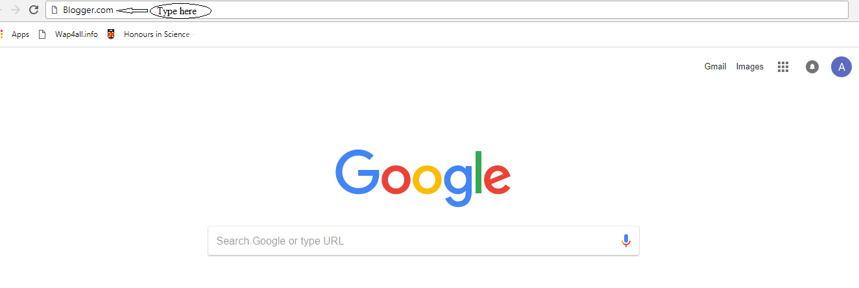
ICT/INNOVATION CENTER, UNN
STEP 1: TYPE THE URL “BLOGGER.COM”

Slide 3
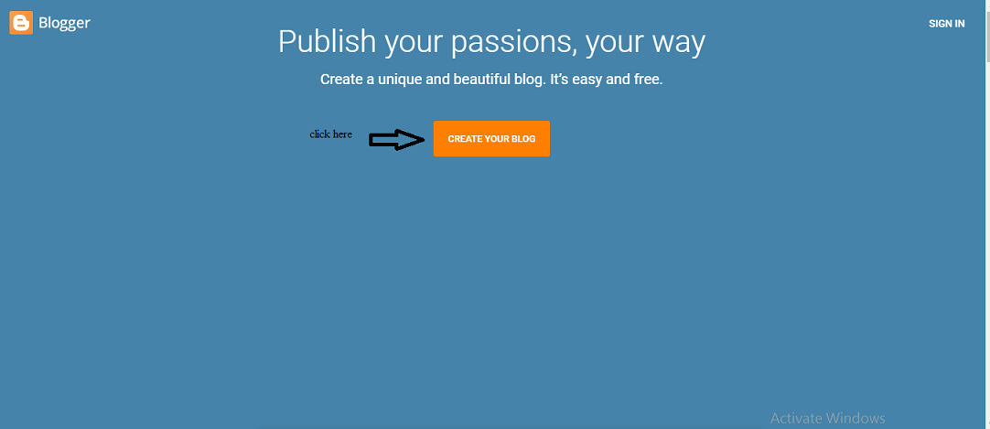
ICT/INNOVATION CENTER, UNN
STEP 2: CLICK ON CREATE BLOG

Slide 4
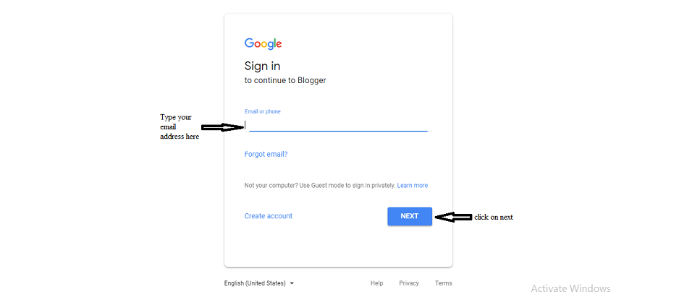
ICT/INNOVATION CENTER, UNN
STEP 3: TYPE IN YOUR EMAIL ADDRESS AS SHOWN BELOW AND Click NEXT, THEN enter your password

Slide 5
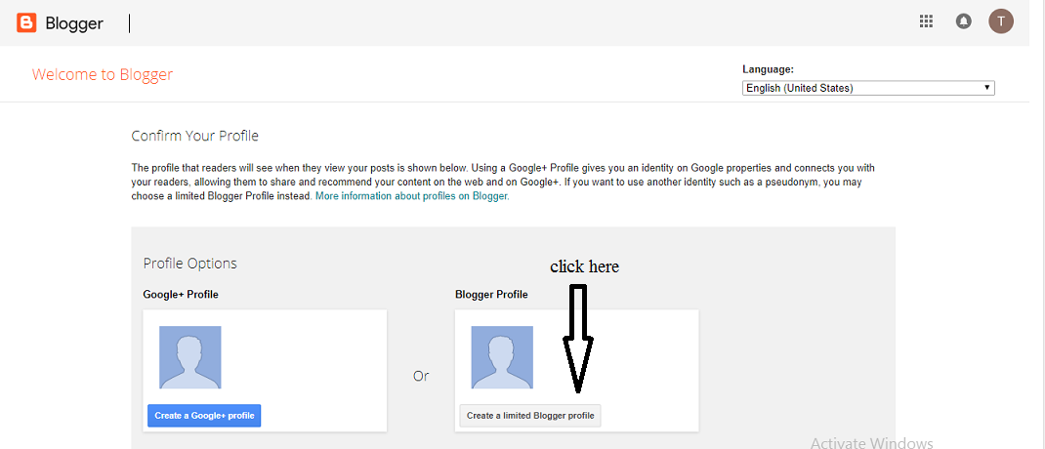
ICT/INNOVATION CENTER, UNN
STEP 4: SELECT Create a limited Blogger

Slide 6
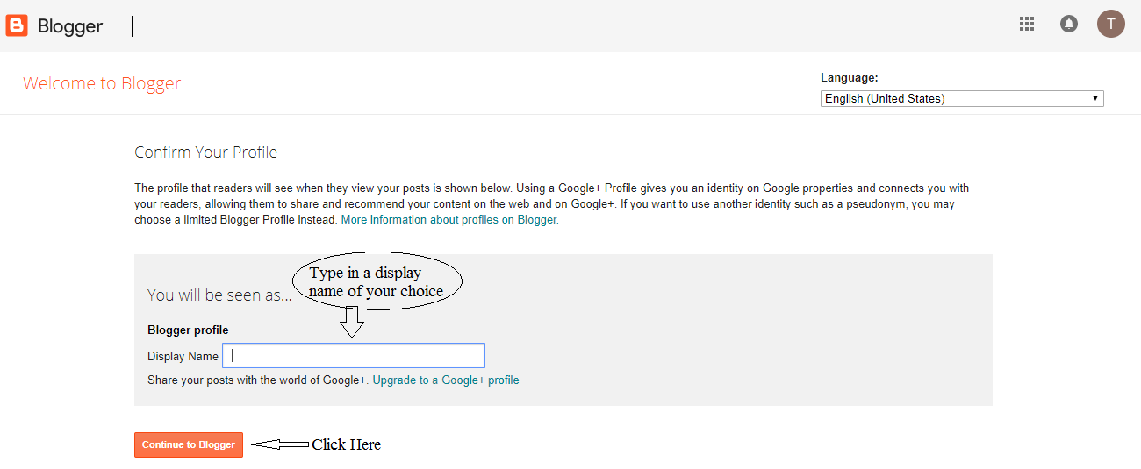
ICT/INNOVATION CENTER, UNN
STEP 5: TYPE IN A DISPLAY NAME

Slide 7
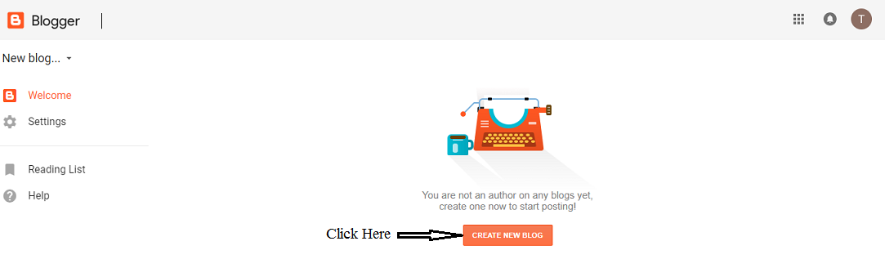
ICT/INNOVATION CENTER, UNN
STEP 6: SELECT “CREATE NEW BLOG”

Slide 8
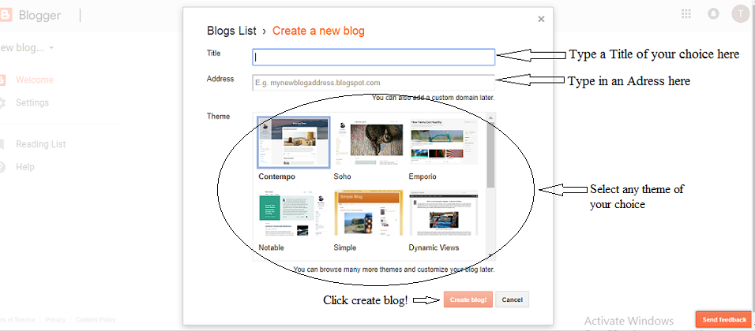
ICT/INNOVATION CENTER, UNN
STEP 7: TYPE YOUR TITLE,YOUR ADRESS, SELECT A THEME AND CLICK ON CRAETE BLOG

Slide 9
UNIVERSITY OF NIGERIA, NSUKKA
OFFICE oF THE VICE CHANCELLOR
ICT/INNOVATION CENTER
HOW TO LINK AND POST ON YOUR BLOG

Slide 10
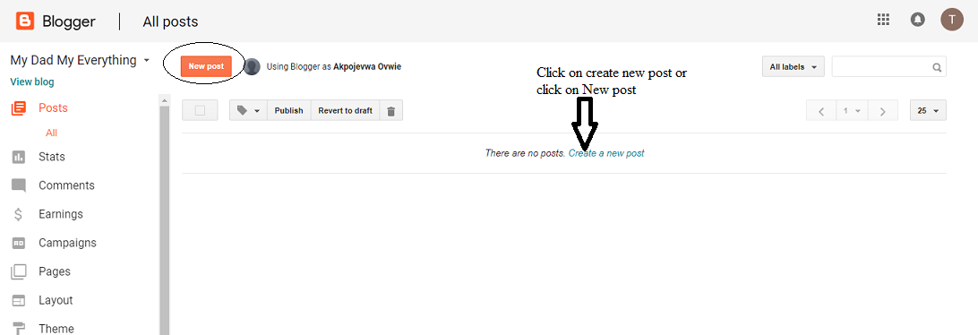
ICT/INNOVATION CENTER, UNN
STEP 8: CLICK ON CREATE A NEW POST OR NEW POST

Slide 11
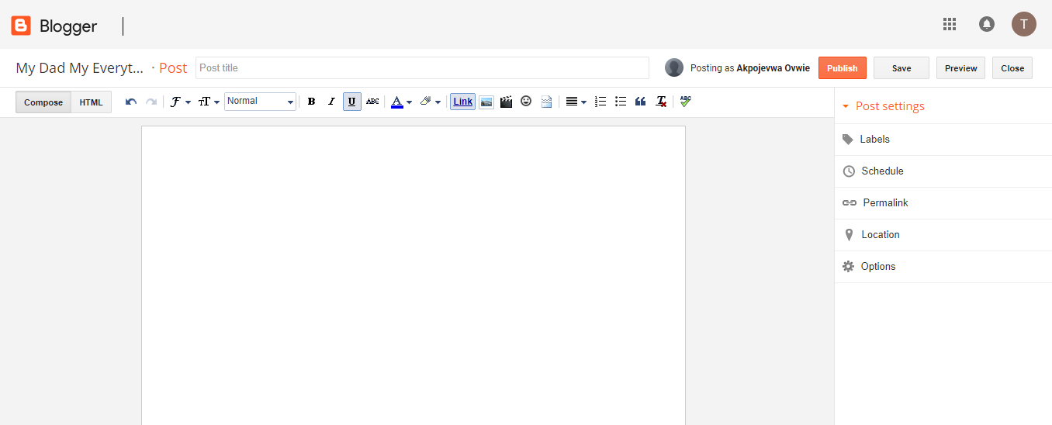
ICT/INNOVATION CENTER, UNN
STEP 9:

Slide 12
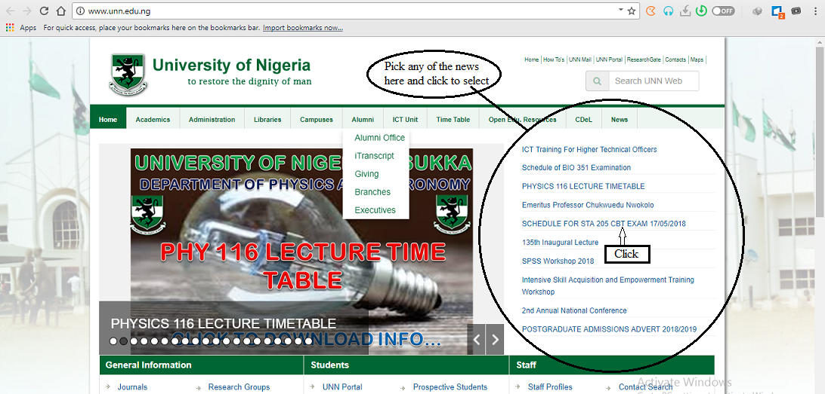
ICT/INNOVATION CENTER, UNN
STEP 10: FROM THE UNN HOMEPAGE, CLICK ON THE INFORMATION THAT YOU WANT TO POST

Slide 13
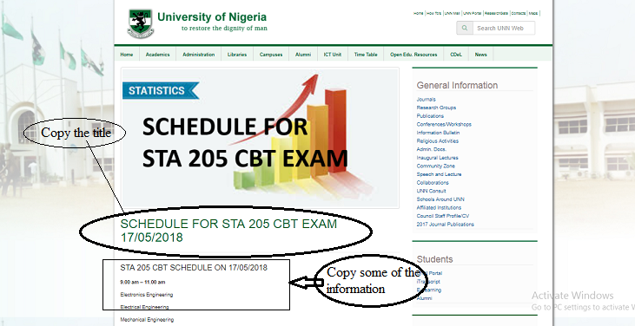
ICT/INNOVATION CENTER, UNN
STEP 11:COPY THE TITLE FIRST, Go back to the blog

Slide 14
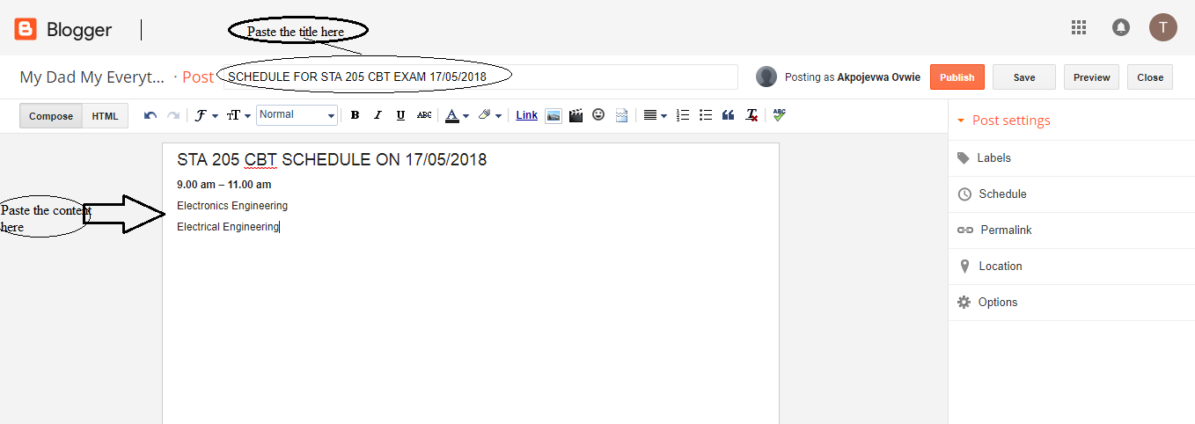
ICT/INNOVATION CENTER, UNN
STEP 12:paste the title first

Slide 15
ICT/INNOVATION CENTER, UNN
STEP 13:COPY some of the content as shown below, Go back to the blog

Slide 16
ICT/INNOVATION CENTER, UNN
STEP 14:PASTE THE CONTENT AS SHOWN BELOW

Slide 17
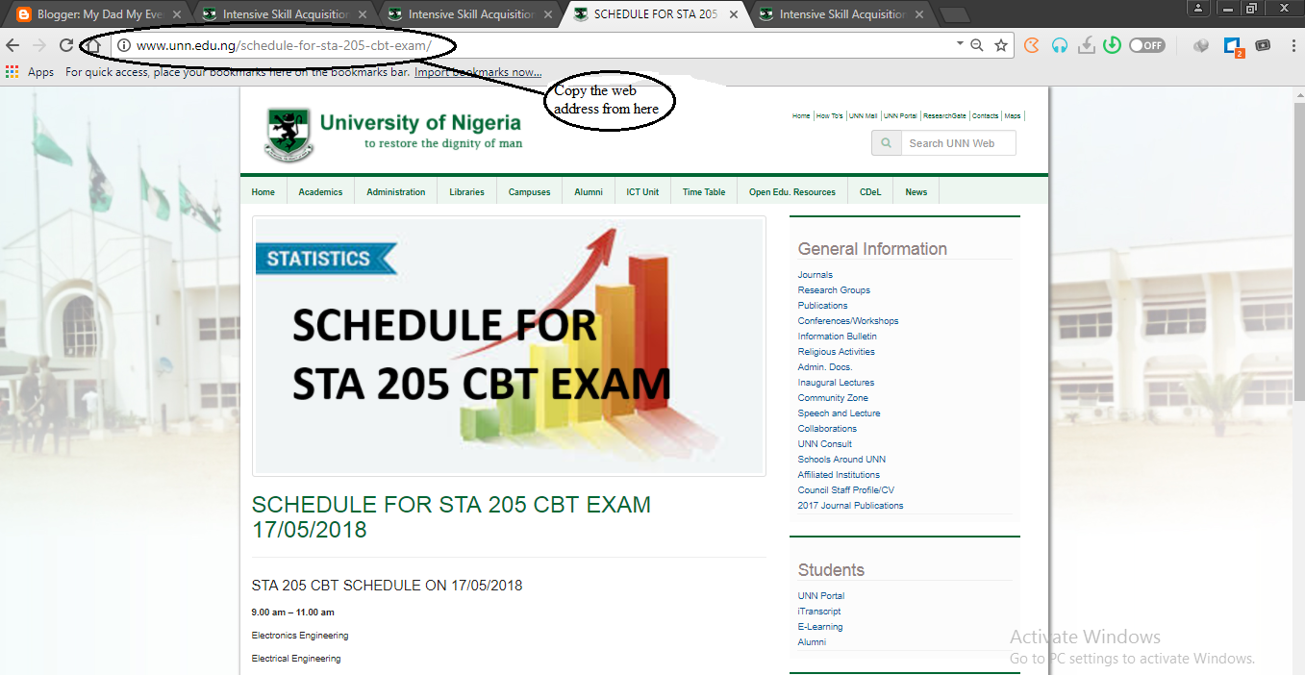
ICT/INNOVATION CENTER, UNN
STEP 15:BACK TO UNN HOMEPAGE, COPY THE URL/WEB ADRESS AS SHOWN

Slide 18
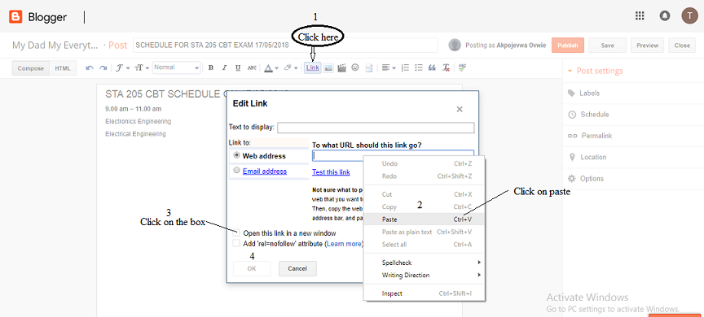
STEP 16:FIRST CLICK ON LINK,THEN PASTE ON THE WEB ADRESS, CLICK ON OPEN THIS LINK CHECK BOX AND THEN CLICK OK

Slide 19
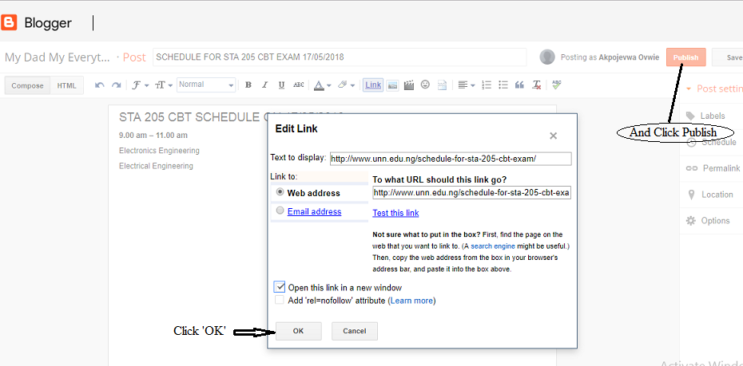
ICT/INNOVATION CENTER, UNN
STEP 17:FROM STEP 16, it will look like this, then click publish

Slide 20
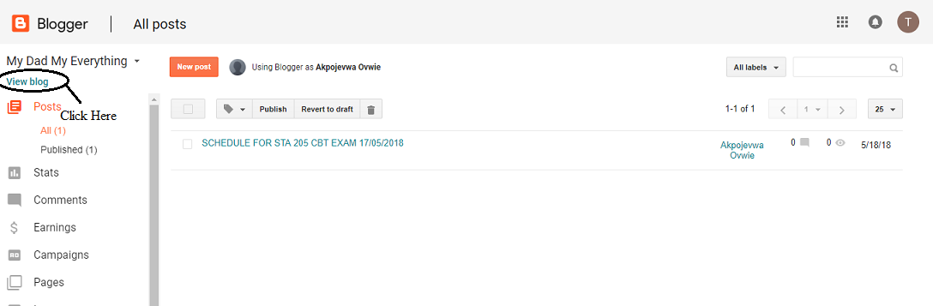
ICT/INNOVATION CENTER, UNN
STEP 18: TO VIEW YOUR BLOG, click on view blog

Slide 21
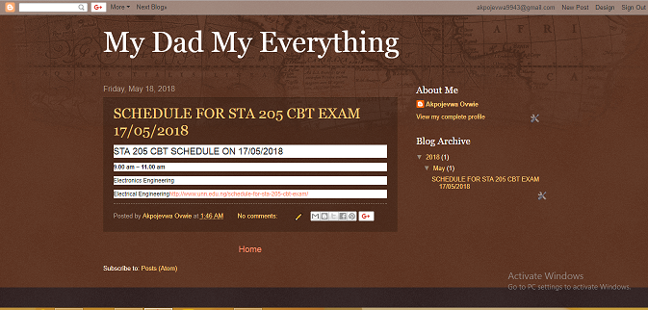
ICT/INNOVATION CENTER, UNN
STEP 19: YOUR BLOG IS READY

Slide 22
UNIVERSITY OF NIGERIA, NSUKKA
OFFICE oF THE VICE CHANCELLOR
ICT/INNOVATION CENTER
THANK YOU

