Slide 1
HOW TO CREATE A WEBSITE USING SIMPLESITE
BY
IMMANUEL ENGELS

Slide 2
Building your Website
Building a website can cost anywhere between $100 and $500. If you need a feature-rich, custom-built website, it can go as high as $30,000 or more. To build a small website, you'll need to have a budget for the domain name and web hosting. Building a website involves knowledge of languages involved in building a website.

Slide 3
Website Builders
Website builders typically require customers to sign up with the web hosting company. The main advantage of a website builder is that it is quick and easy to use, and often does not require prior experience or coding skills. Often, a website can be built and be up and running live on the Internet quickly. Technical support is usually provided, as are how-to video and help files.

Slide 4
SIMPLESITE
SimpleSite is a user-friendly and customizable blog hosting platform. With SimpleSite, creating stunning website designs does not require complex coding knowledge. Simplesite lets users apply themes and customize them with ease to reflect their branding or personality through the platform’s guided design wizard. Furthermore, SimpleSite blogs are optimized for mobile. Each page adapts to every screen size, letting readers enjoy content that fits perfectly on their preferred devices.

Slide 5
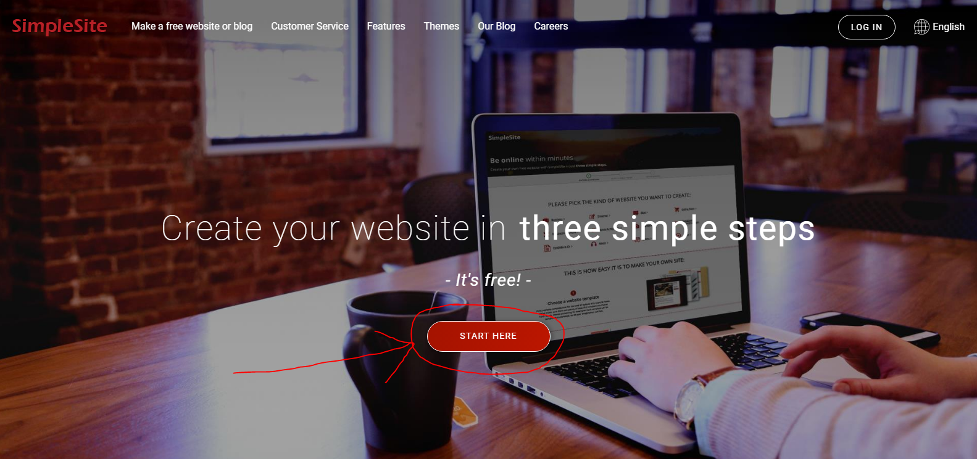
Create your first Website with Simplesite
Visit https://www.simplesite.com/ and click on the start here button

Slide 6
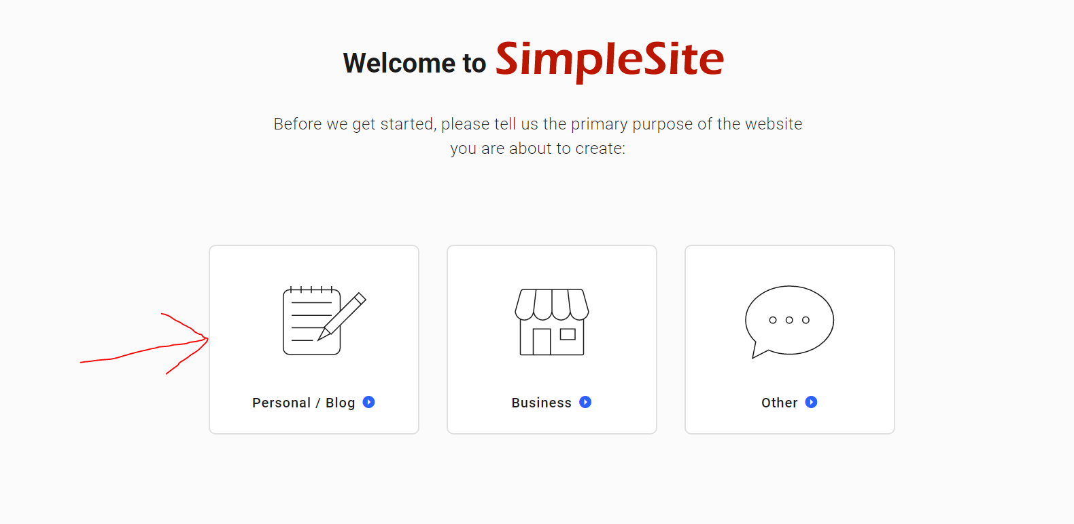
In the next screen that appears, select an option.

Slide 7
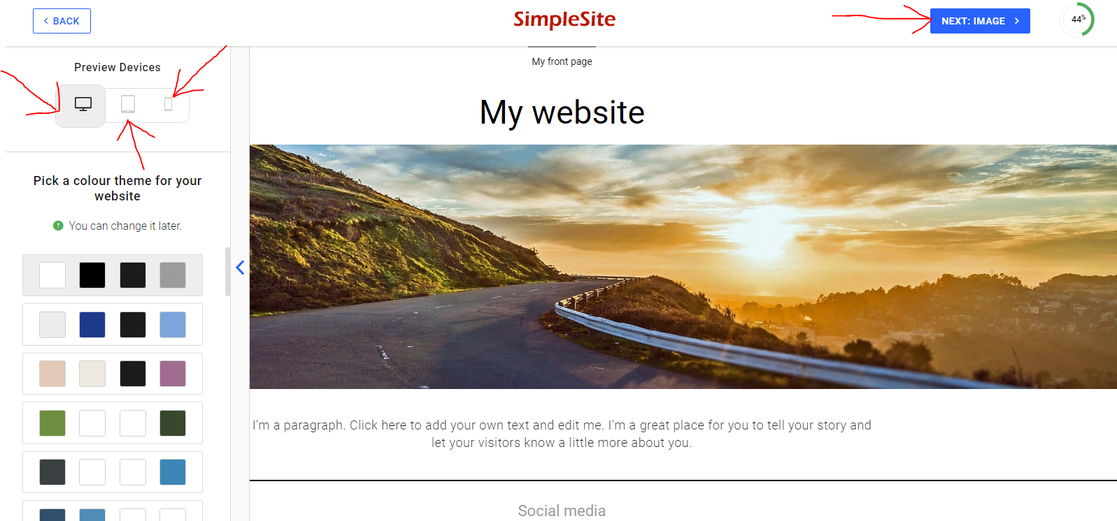
Here, you are to select theme colour theme for your website. You can also preview your website across various devices. Click Next: Image after choosing a theme

Slide 8
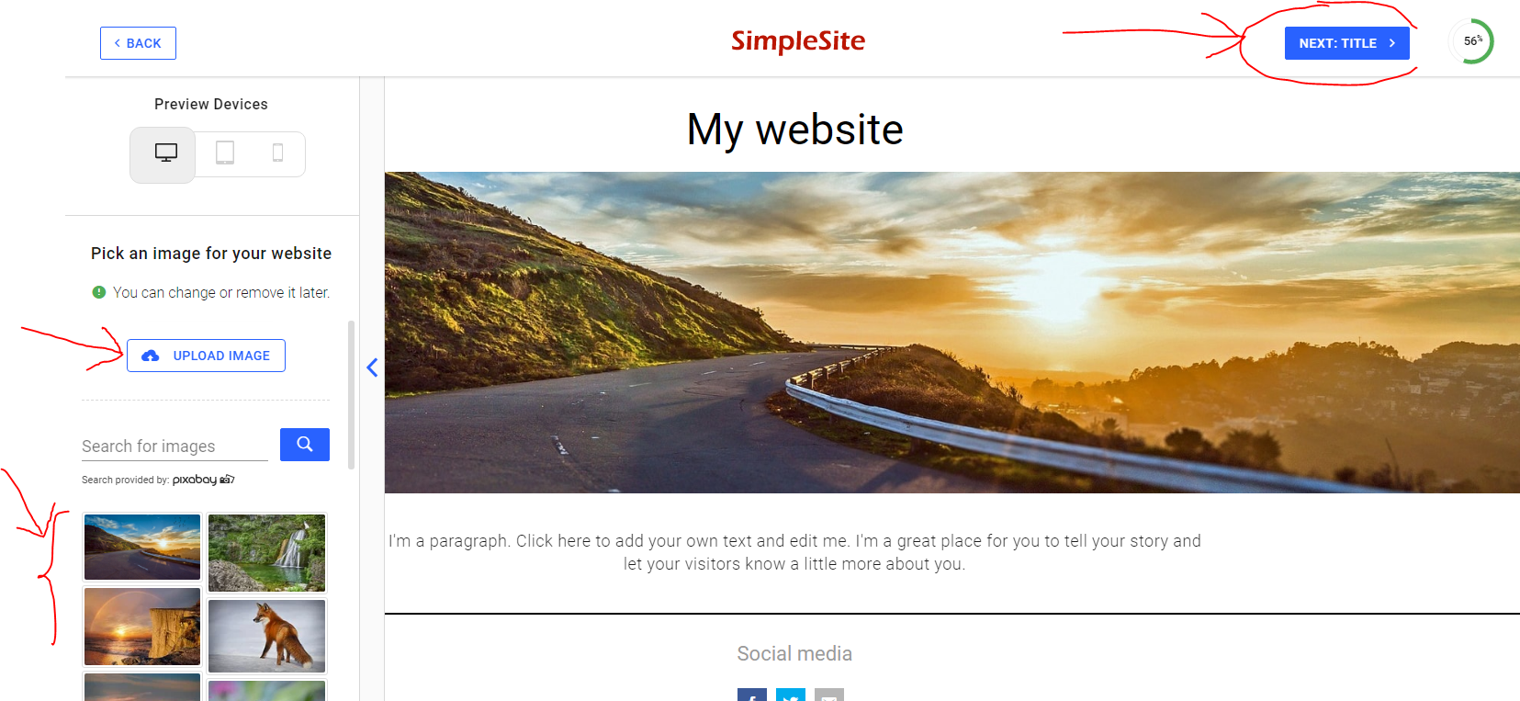
You can select an image of your choice here or decide to upload an image. Click Next: Title after choosing an image

Slide 9
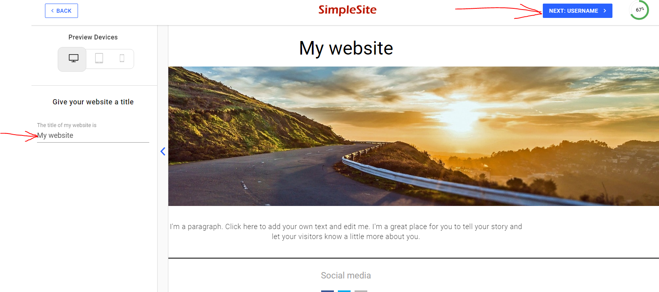
Give your website a title then click Next: Username

Slide 10
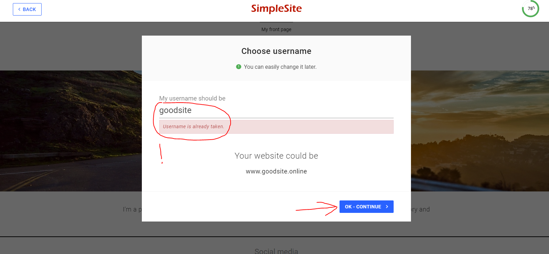
Your username should be unique. Usernames already in use will not be accepted. Click OK- Continue to proceed

Slide 11
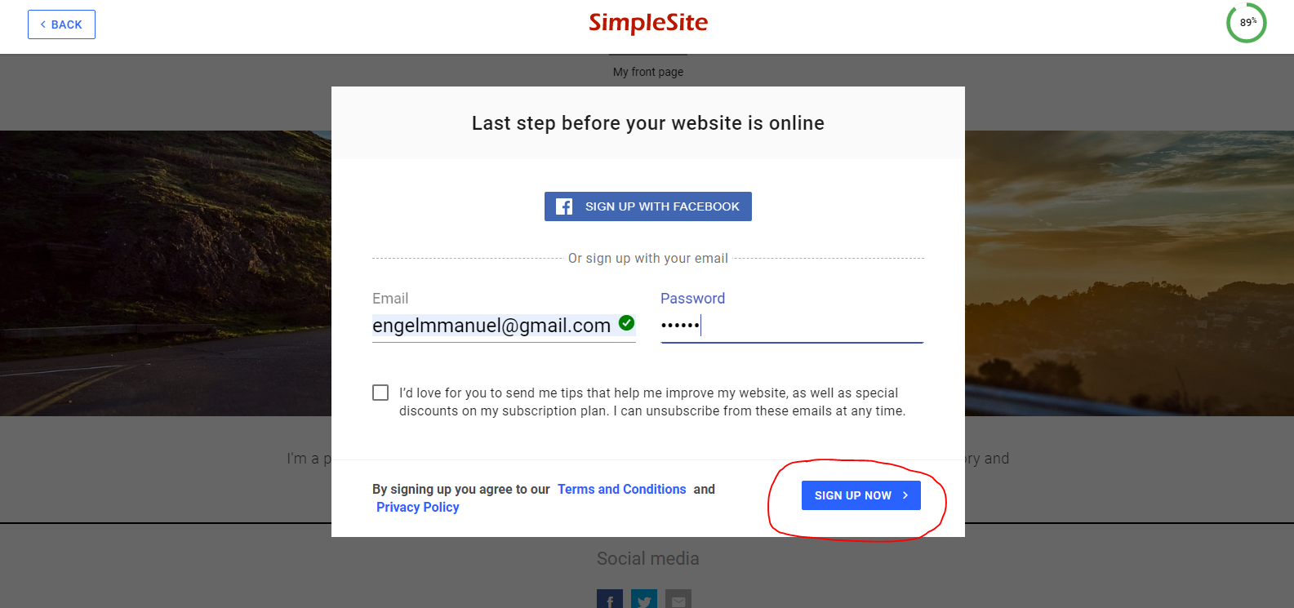
Finally, you need to sign up with either facebook or your email. Click Sign up now to finish your site.

Slide 12
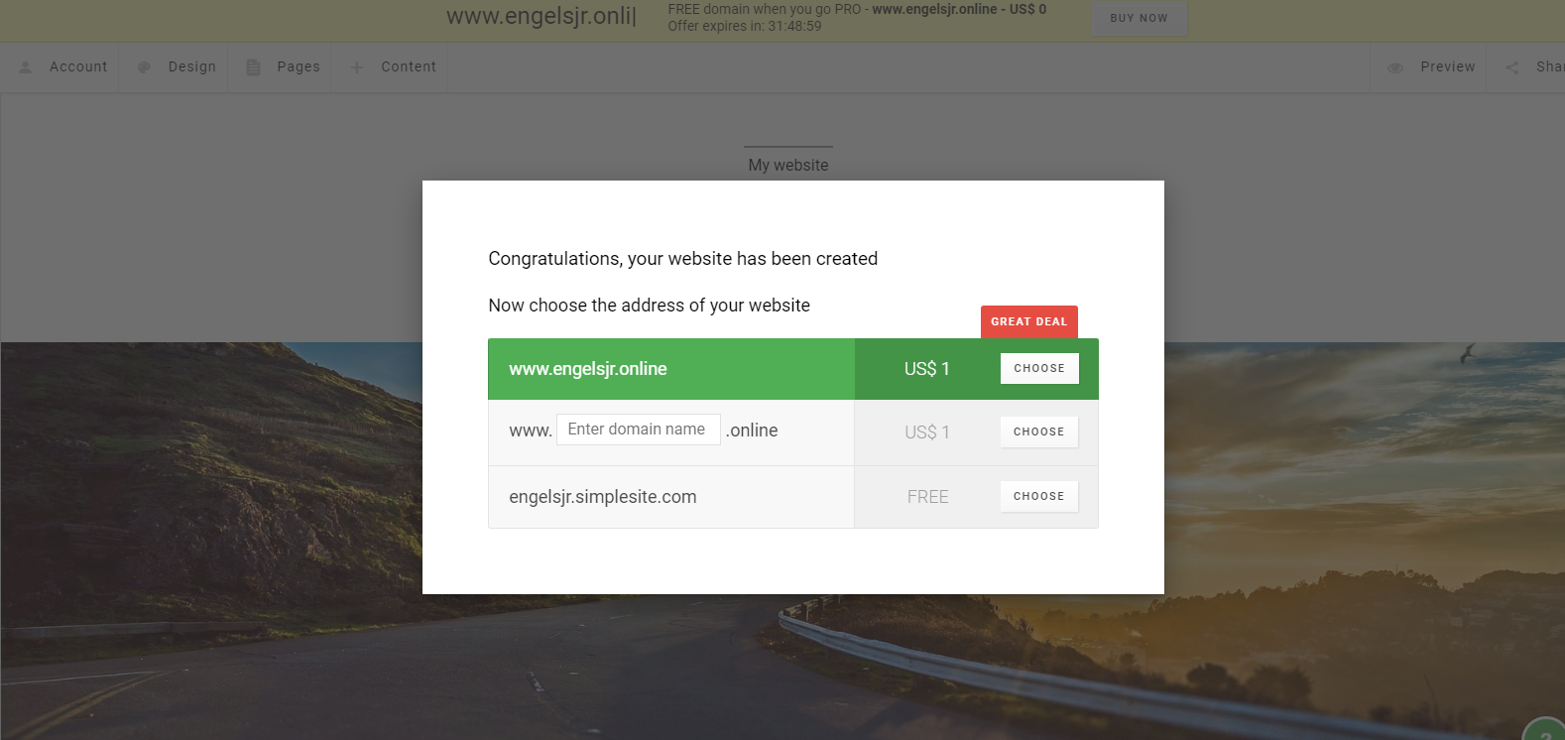
Your website is now created. You can use the default domain or buy a custom domain.

Slide 13
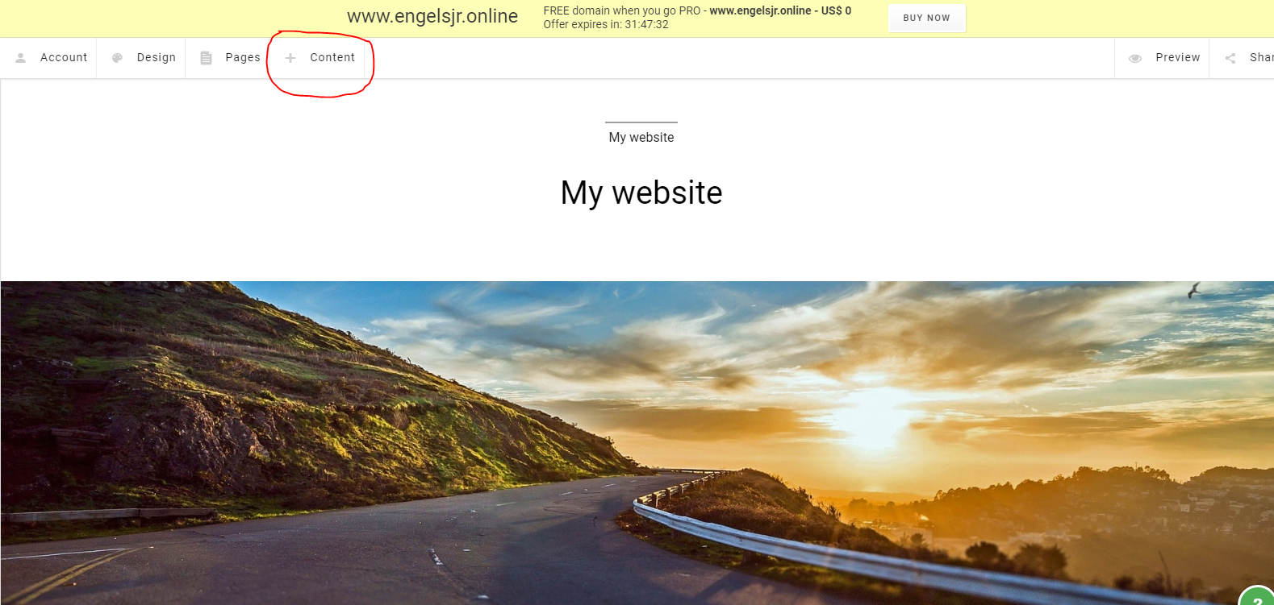
Click content to add content to your just created site.

Slide 14
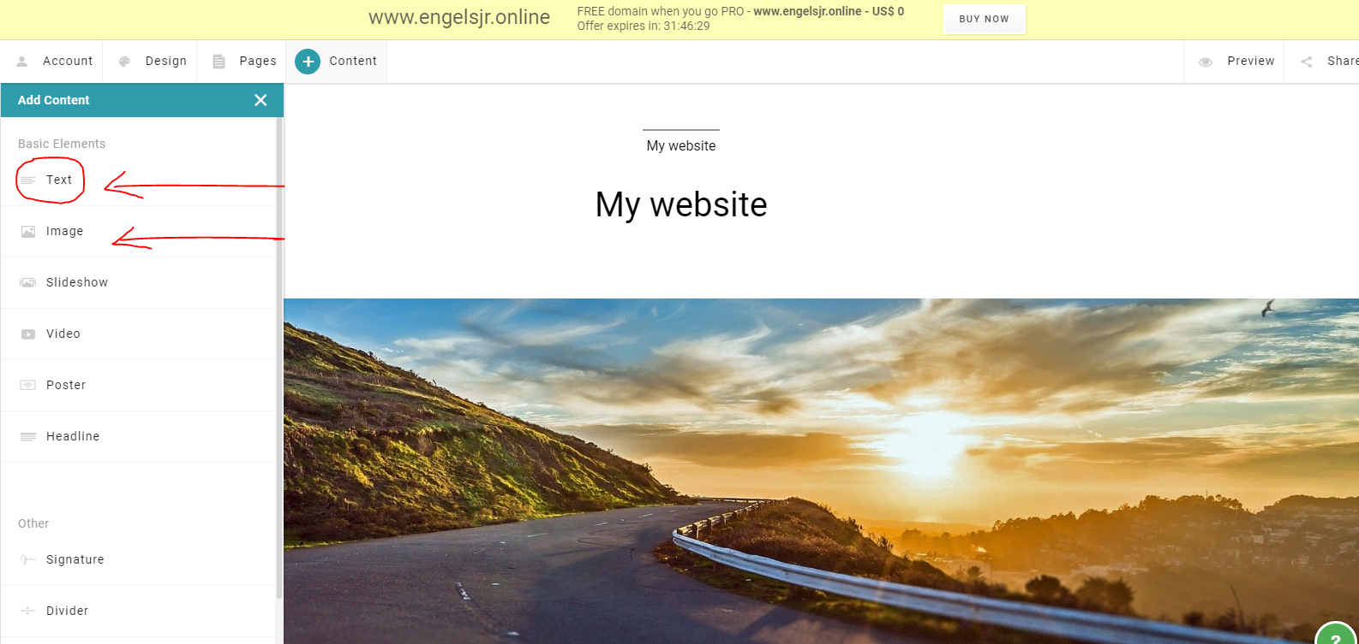
For this example we will add a text and an image. Select text to add text content.

Slide 15
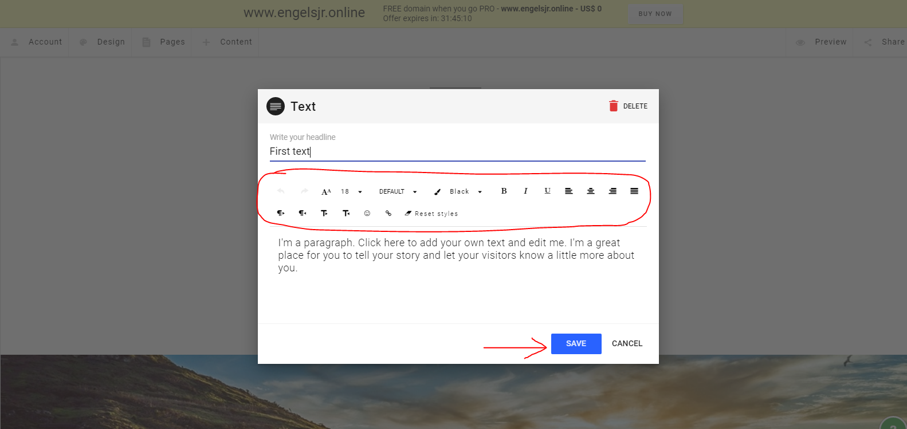
Add the text headline and text body. You can also format your text body with the available formatting tools. Click on save when done.

Slide 16
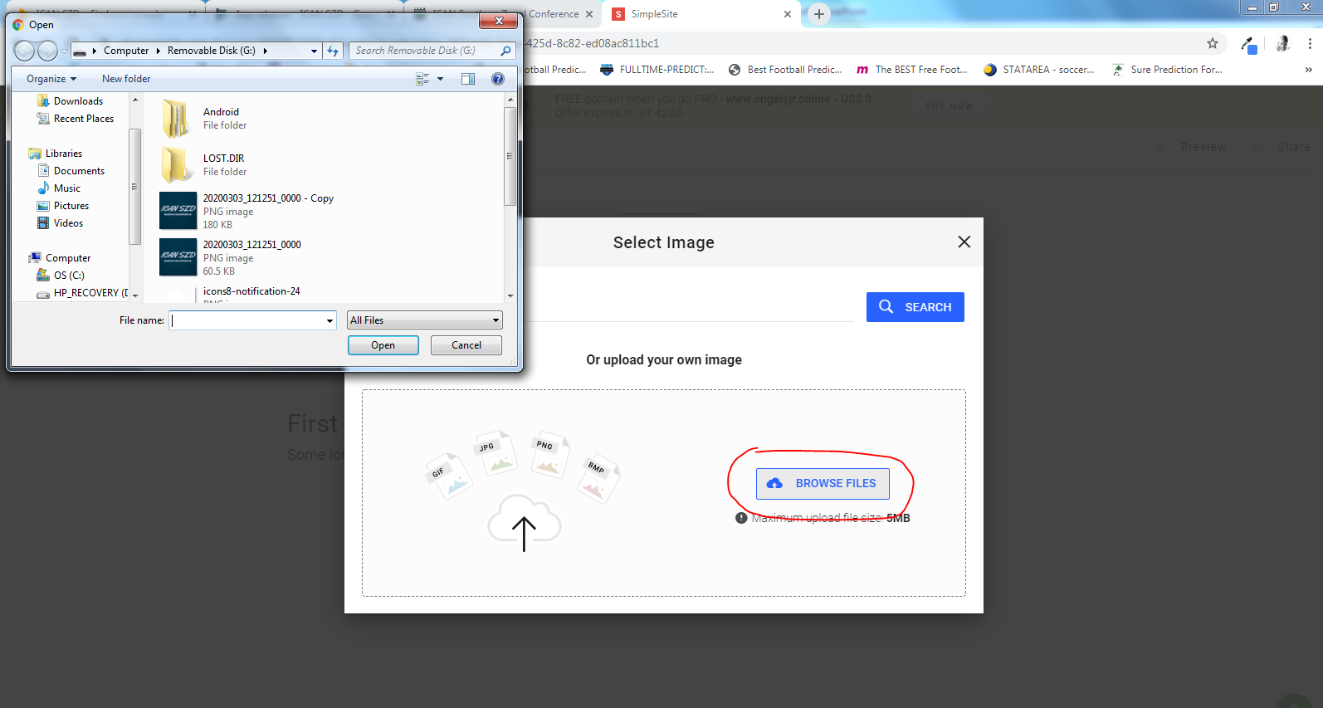
Add image to your website here. Select an image here.

Slide 17
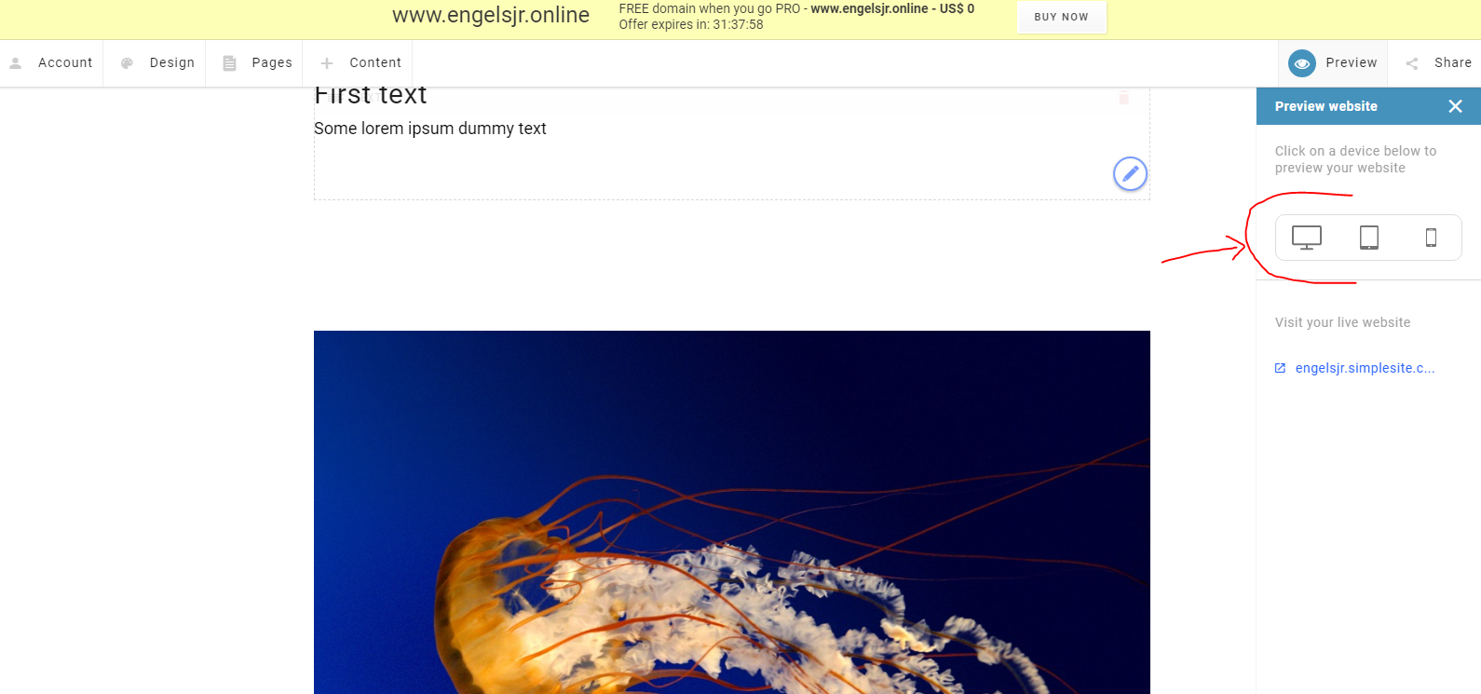
You have successfully added content to your site. You can also preview your website here.

Slide 18
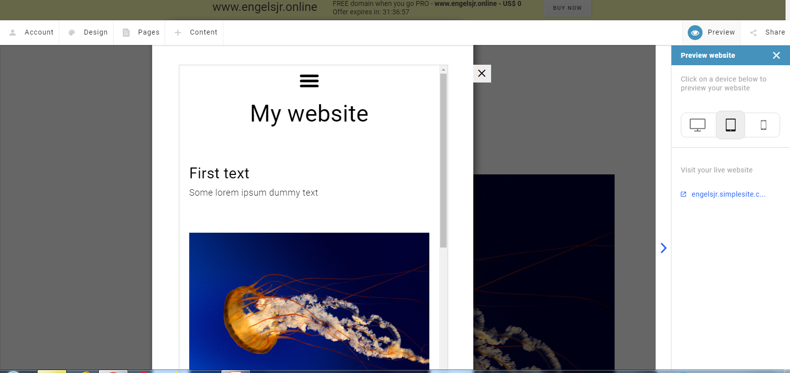
This is a sample of what your website will look like on a mobile device.

