Slide 1
Google Site
Google site is a mini website and a simple site where you can edit and publish your articles.
When you create a new site, it’s automatically added to Drive, like your other files stored in Drive. You can edit a Google Site together with someone else in real time, and see each other’s changes live.
Publish the site for everyone to see, or restrict sharing permissions and make the site accessible only to people you want to share it with, like readers or viewers.
Requirements on how to create a google site
Email Address(eg.Gmail)
Browser

Slide 2
HOW TO CREATE A GOOGLE SITE

Slide 3
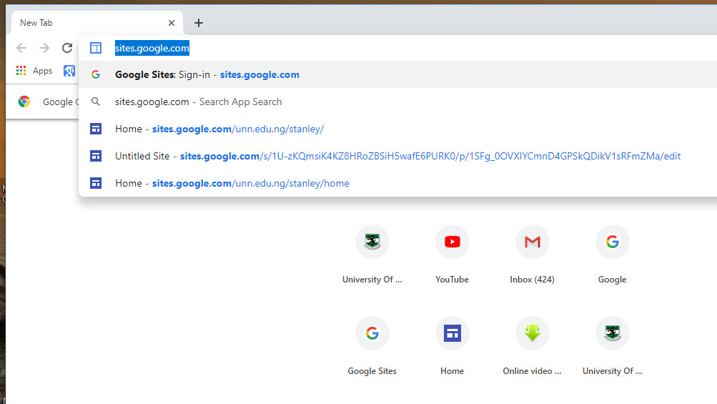

Slide 4
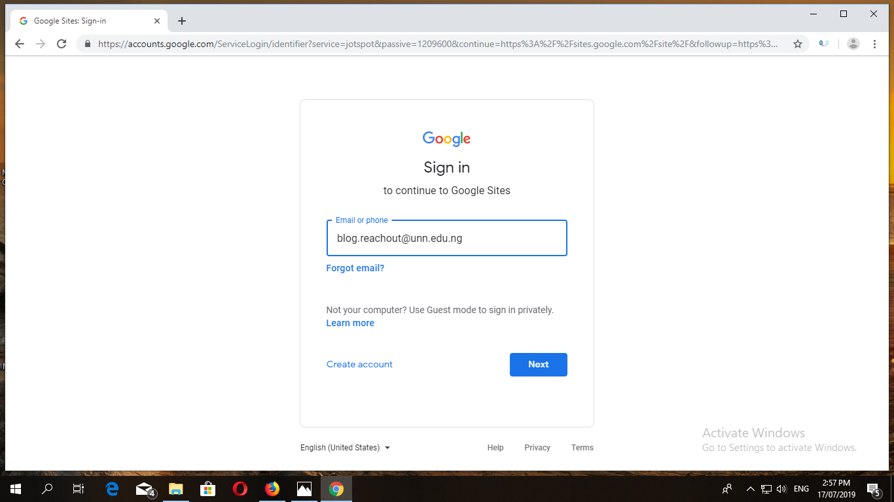

Slide 5
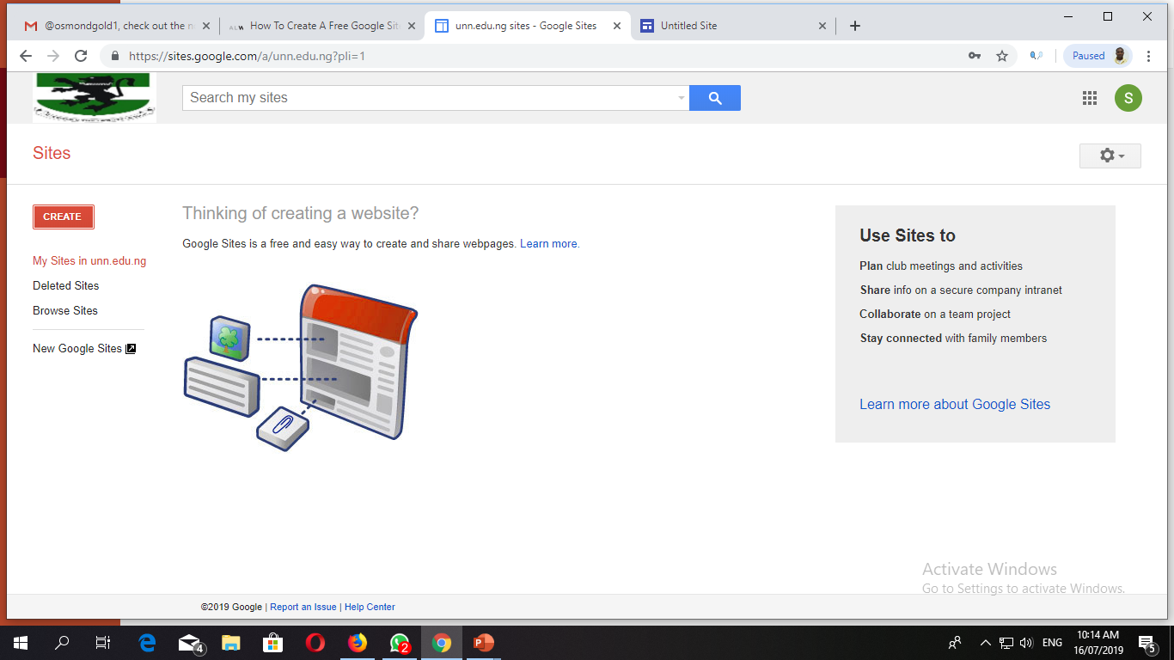

Slide 6
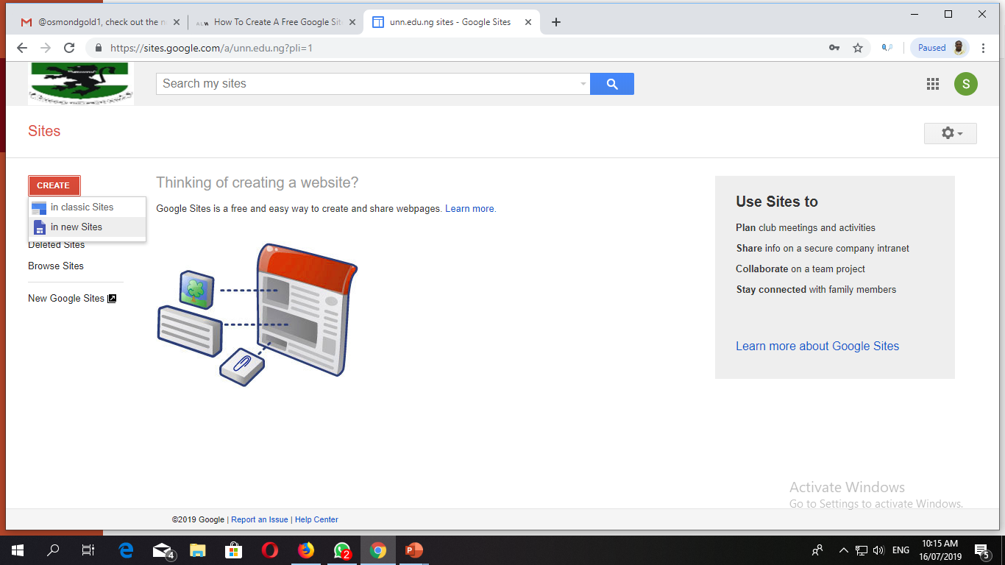

Slide 7
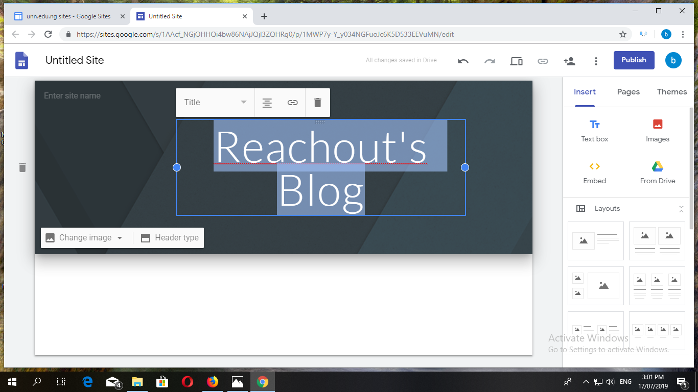
NAME THE TITLE OF YOUR GOOGLE SITE

Slide 8
HOW TO MAKE A POST AND PUBLISH IN GOOGLE SITES

Slide 9
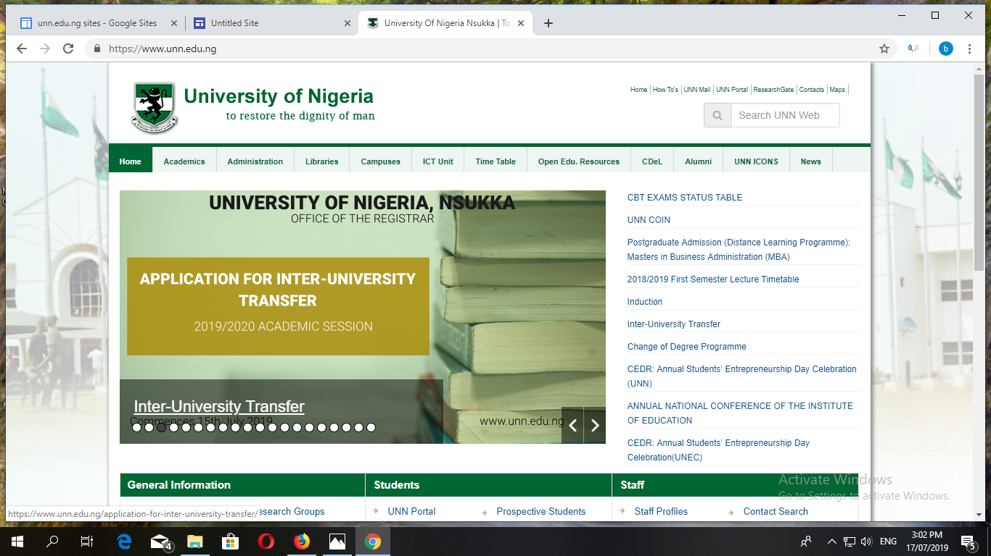

Slide 10
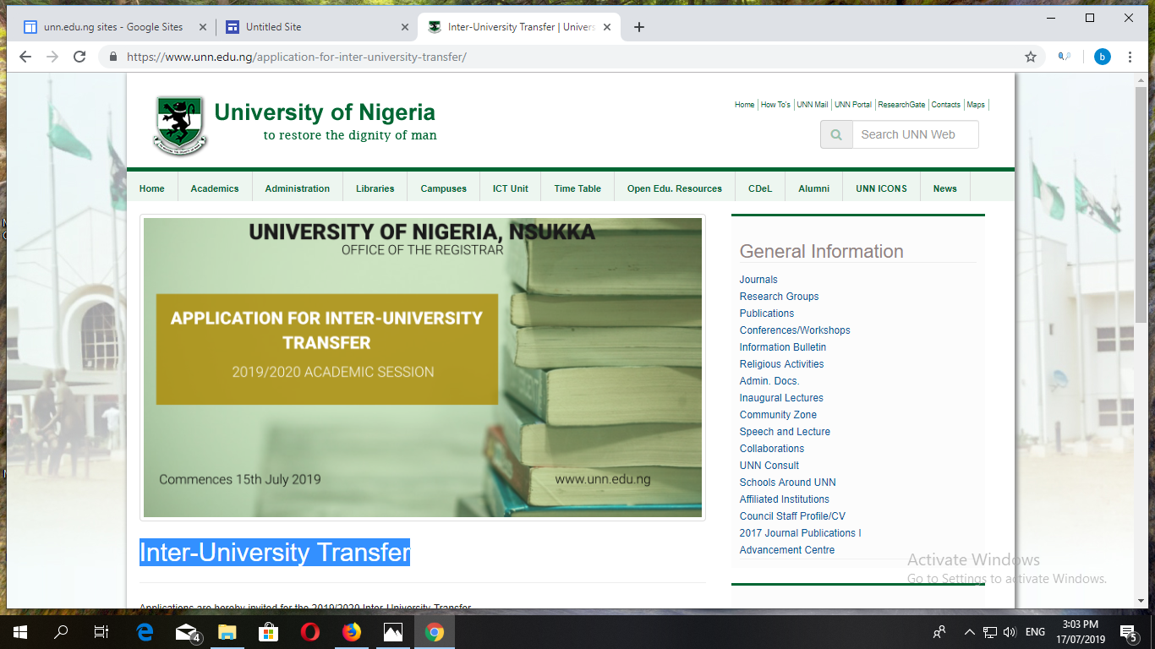

Slide 11
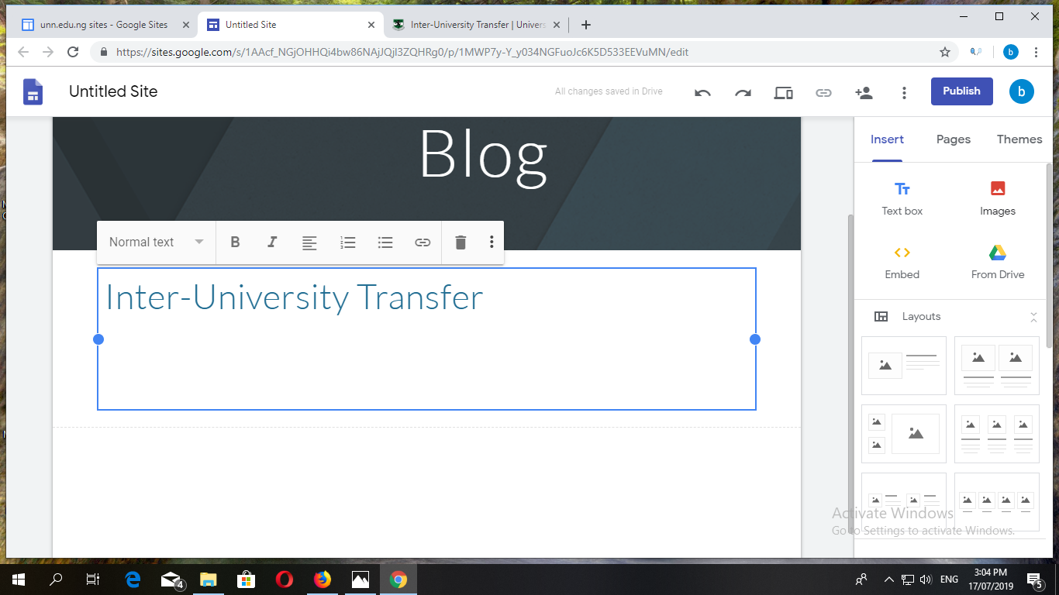

Slide 12
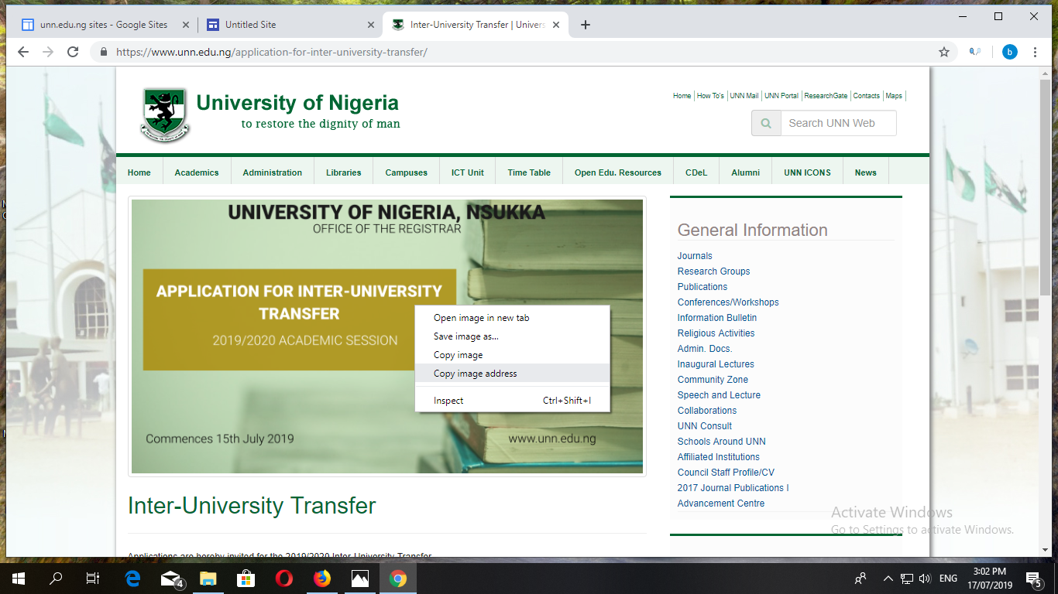

Slide 13
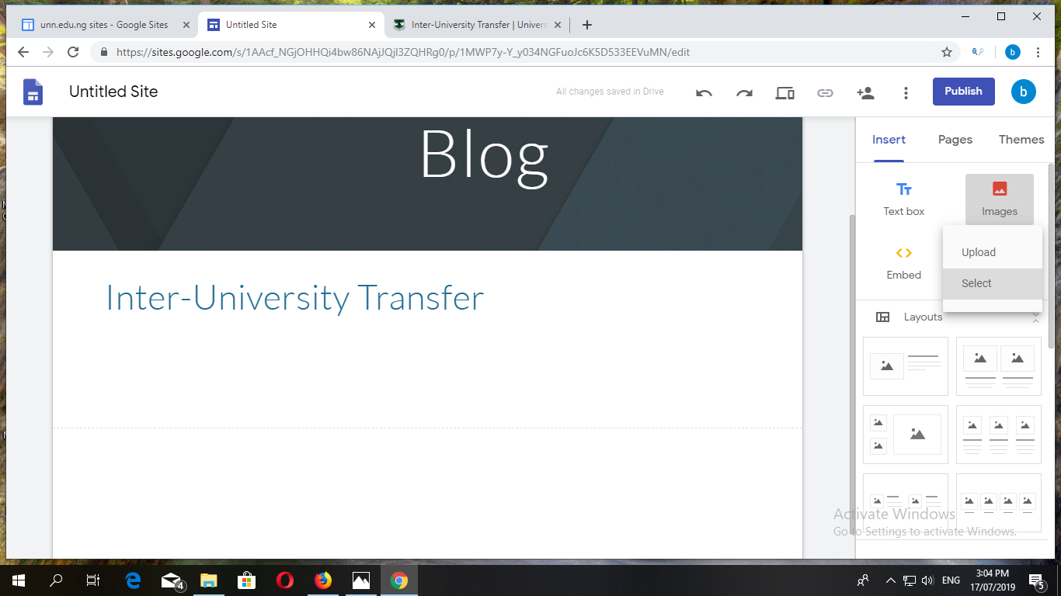

Slide 14
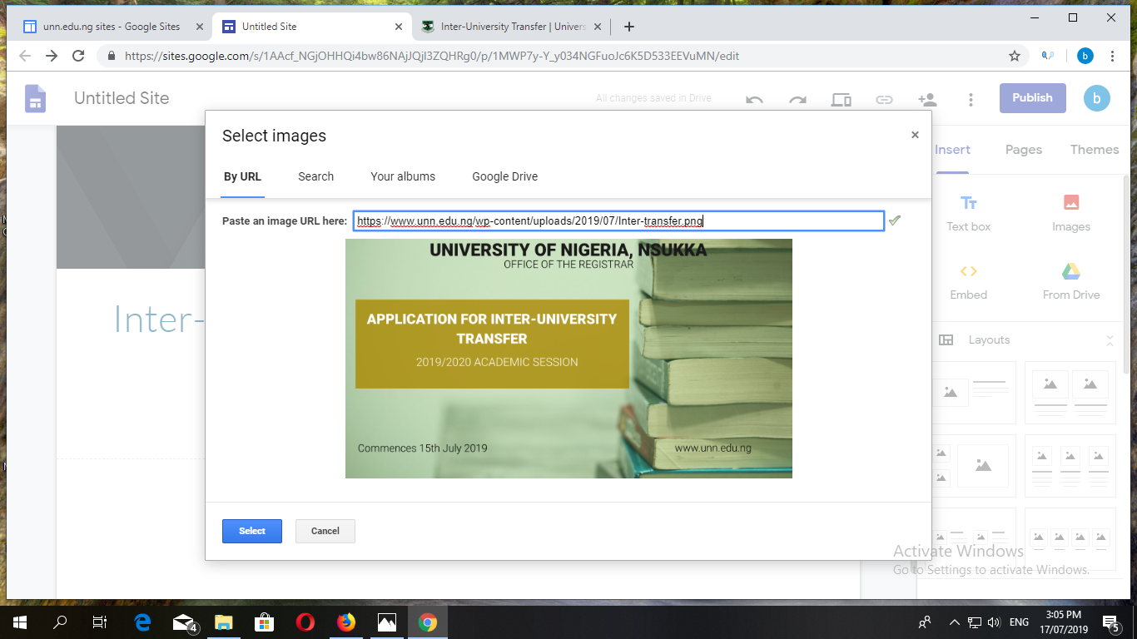

Slide 15
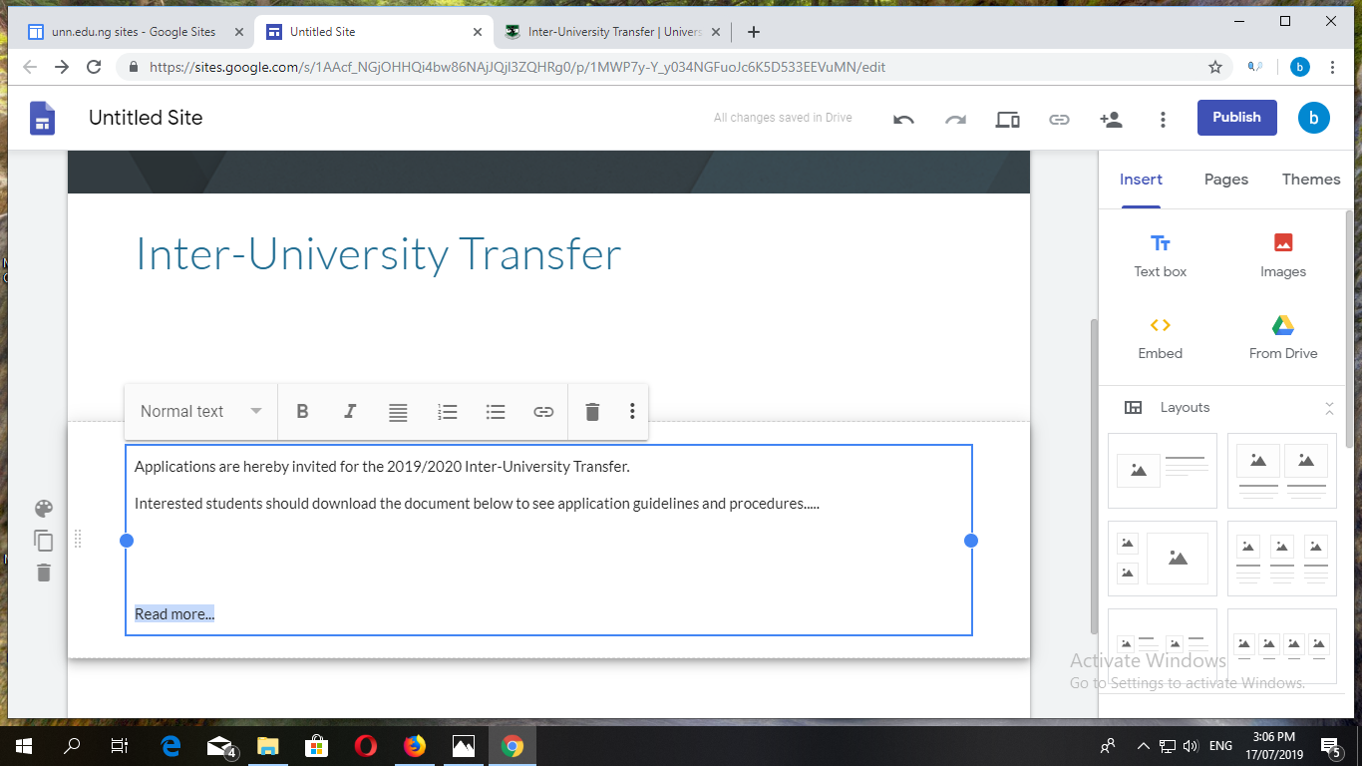

Slide 16
HOW TO BACKLINK A WEBSITE

Slide 17
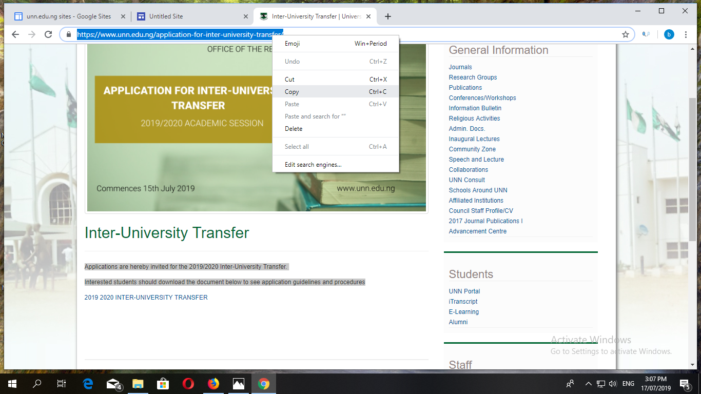

Slide 18
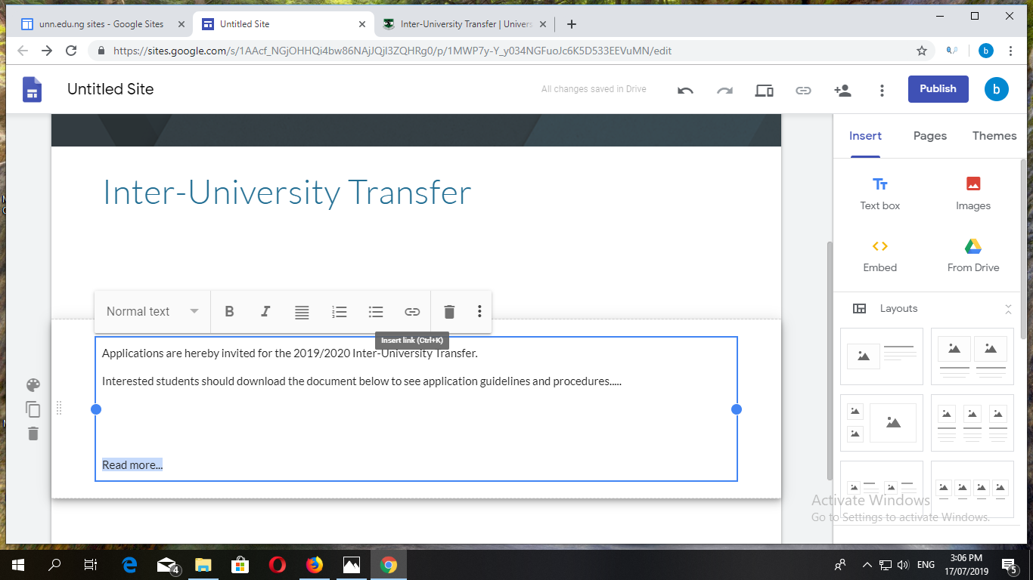

Slide 19
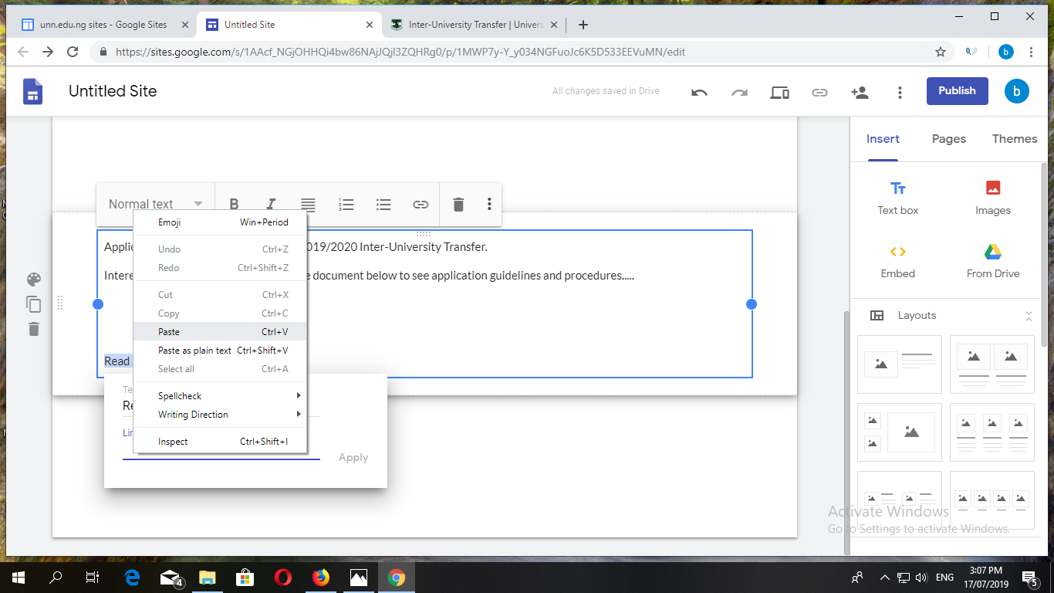

Slide 21
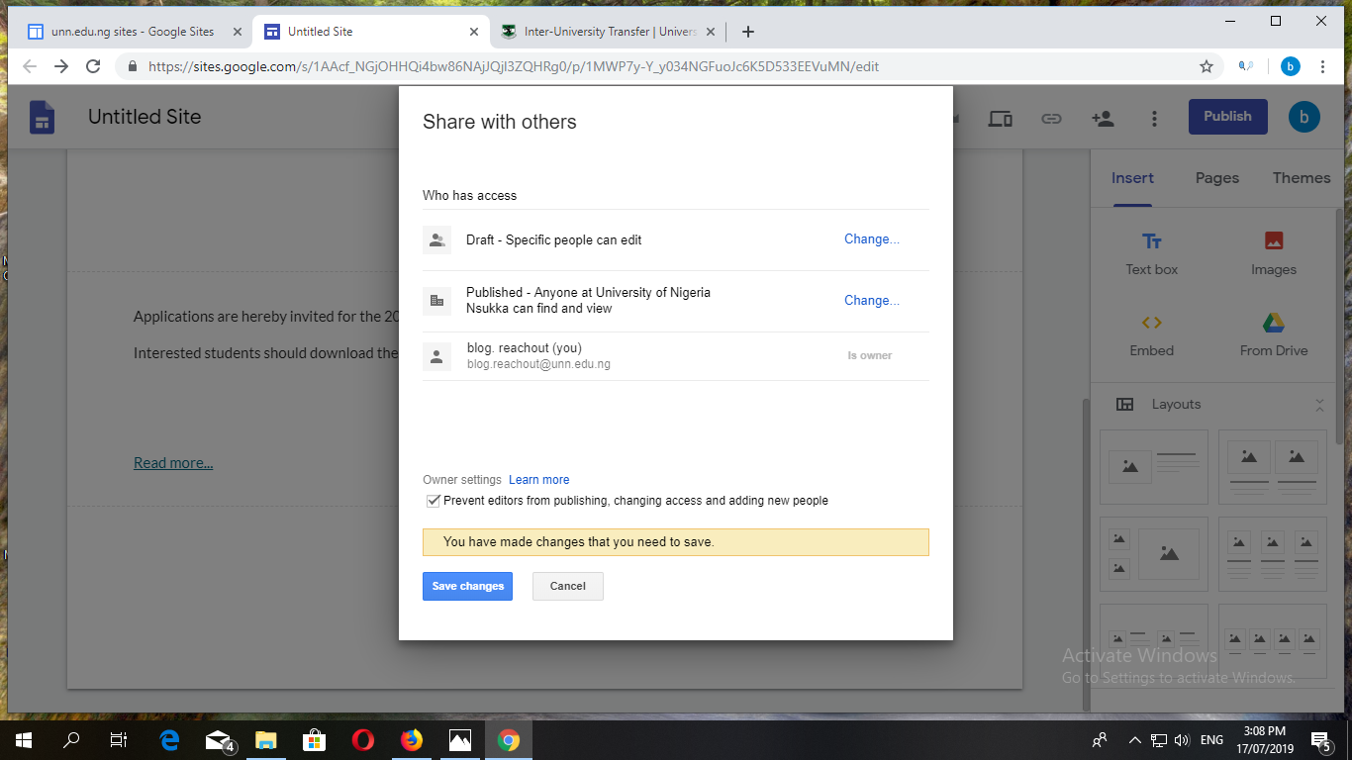

Slide 22
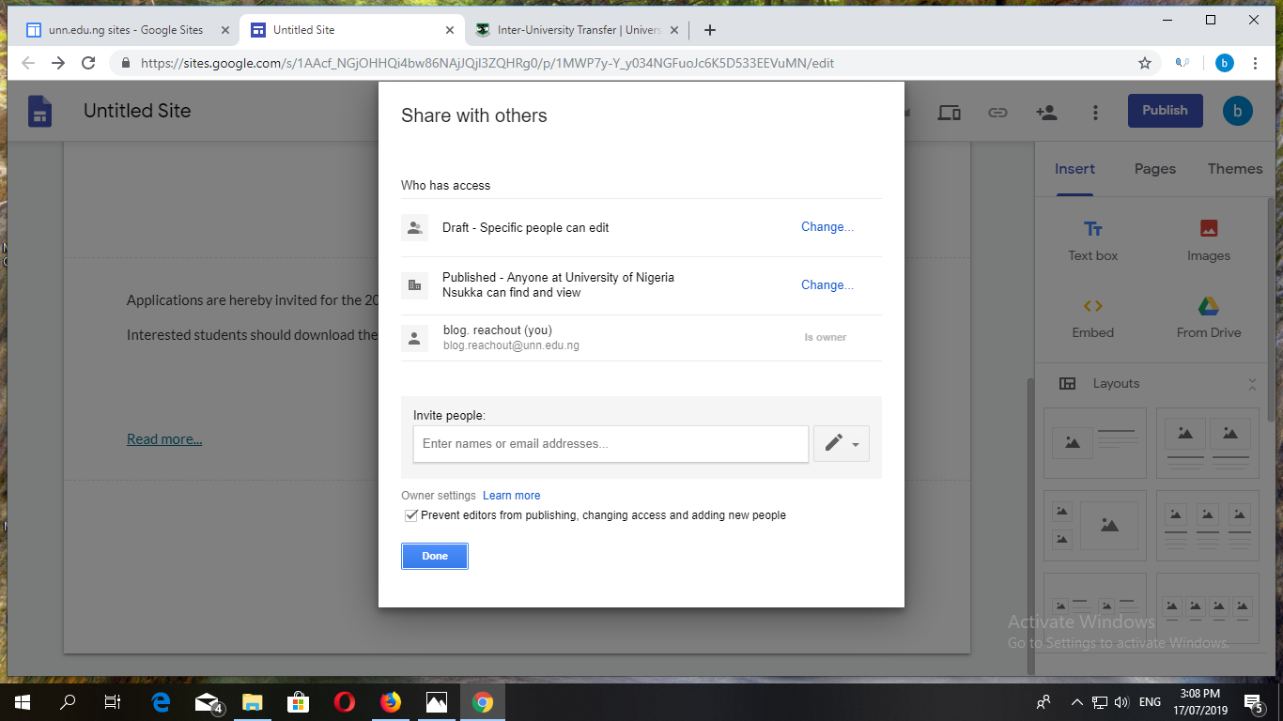

Slide 23
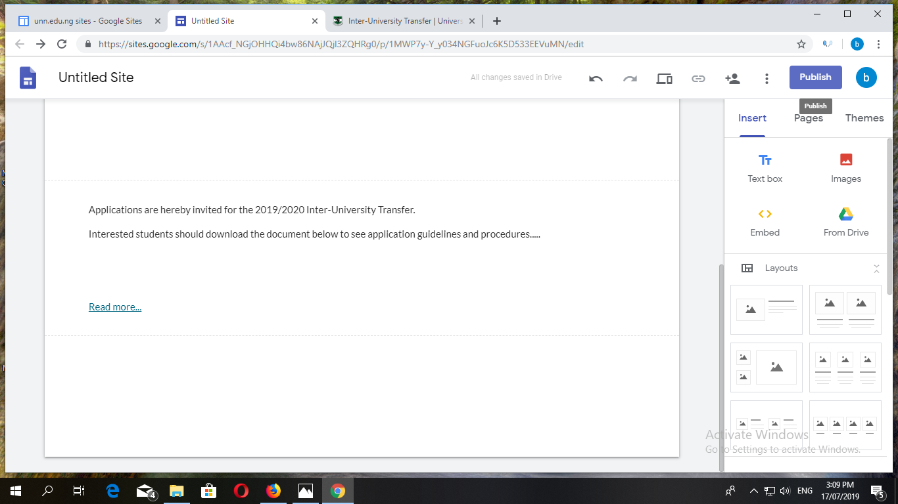

Slide 24
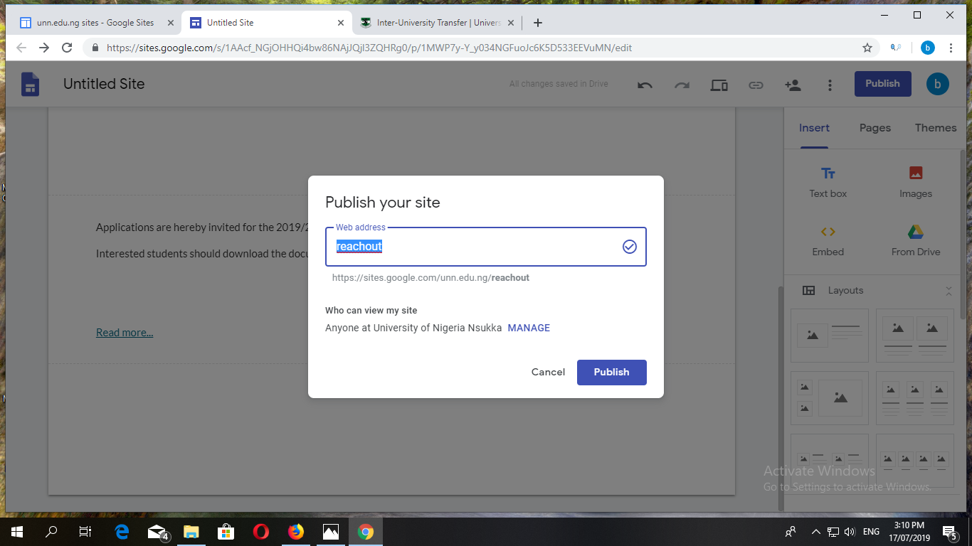

Slide 25
