Slide 2
UNIVERSITY OF NIGERIA, NSUKKA OFFICE oF THE VICE CHANCELLOR ICT/INNOVATION CENTER
WEBNODE CREATION STEPS
By
Webometrics Section
ICT UNIT
UNN

Slide 3
ICT/INNOVATION CENTER, UNN
STEP 1: TYPE THE URL “webnode.com”
TYPE IN THE URL “www.tumblr.com”

Slide 4
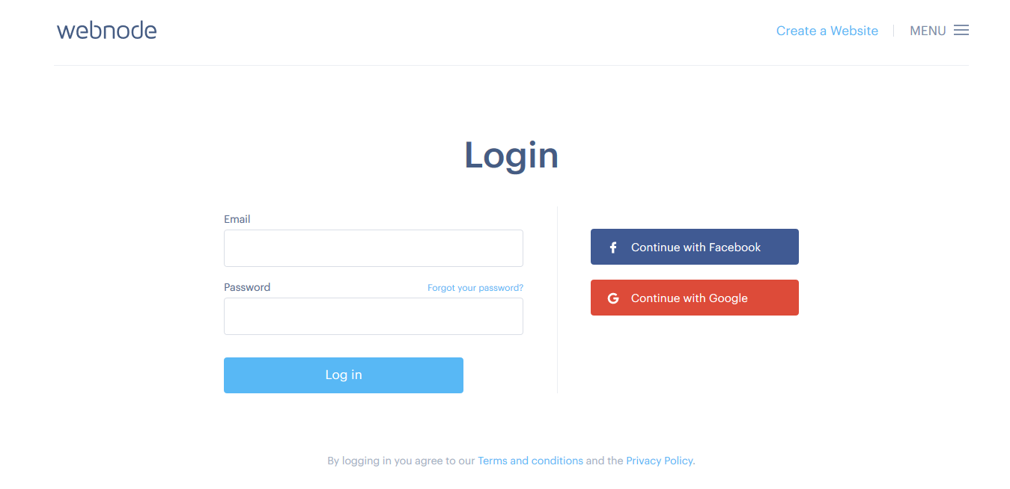
ICT/INNOVATION CENTER, UNN STEP 2: CLICK ON “create a website”
Click on “Get Started”

Slide 5
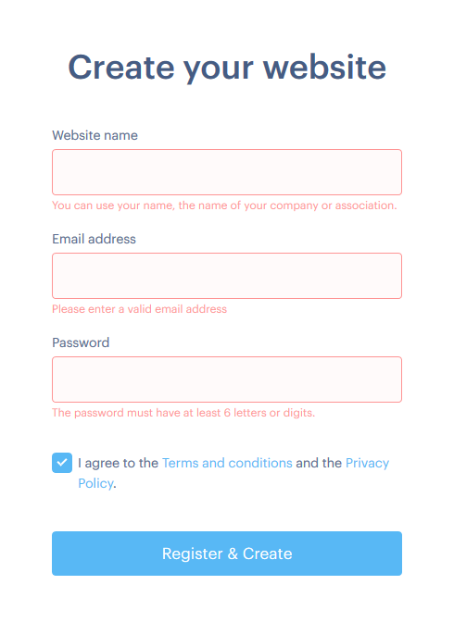
ICT/INNOVATION CENTER, UNN STEP 2: complete the information

Slide 6
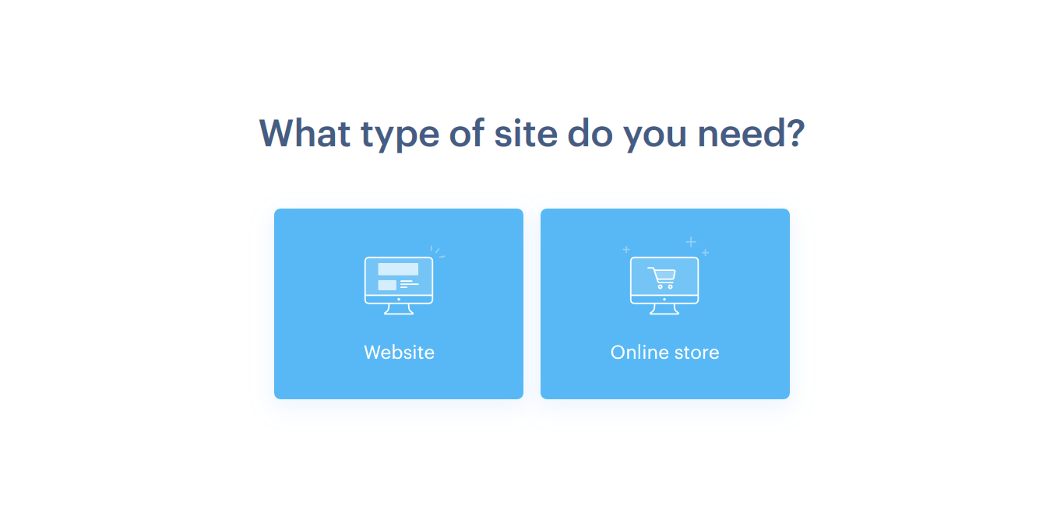
ICT/INNOVATION CENTER, UNN STEP 3: select the field you want.

Slide 7
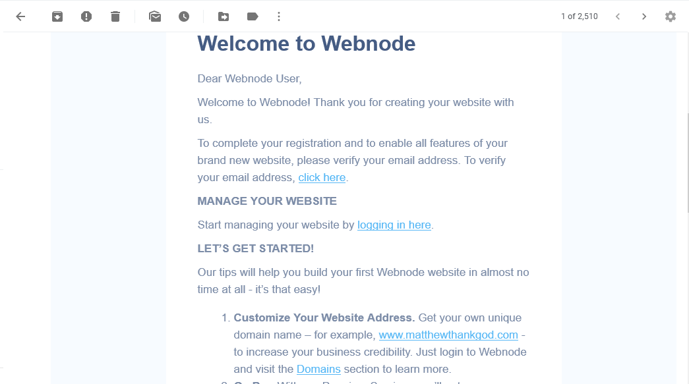
ICT/INNOVATION CENTER, UNN STEP 4: verify your account b y checking your email for this message. Click on “click here”

Slide 8
ICT/INNOVATION CENTER, UNN STEP 6:CLICK ON “BLOG” BEFORE choosing templateS.

Slide 9
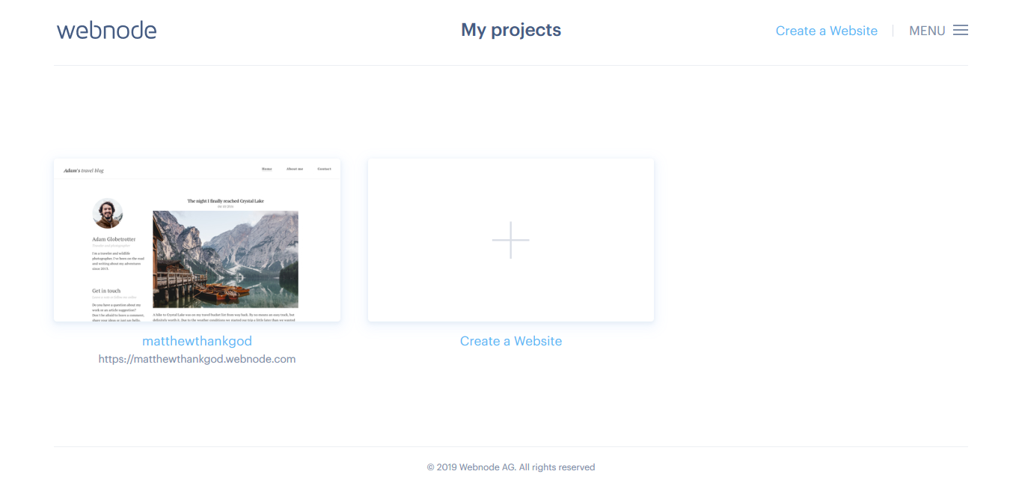
ICT/INNOVATION CENTER, UNN STEP 7: select the template again.

Slide 10
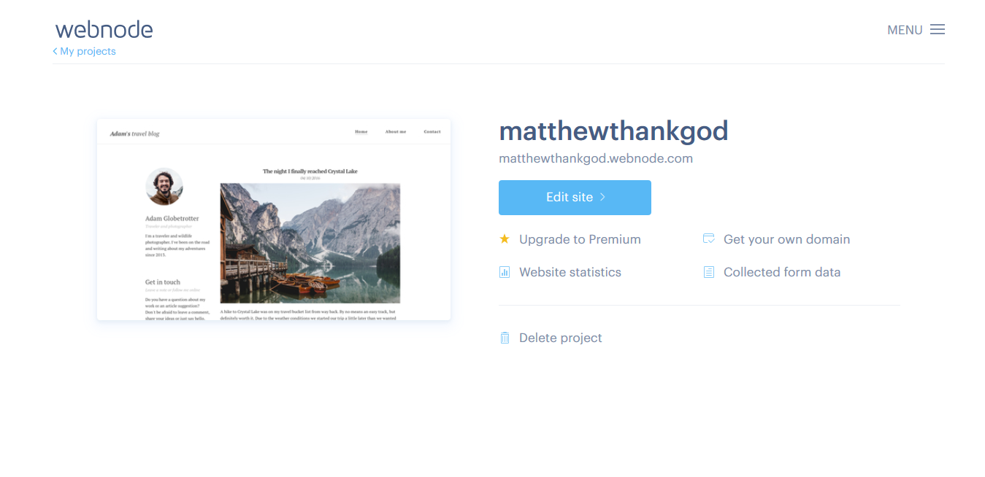
ICT/INNOVATION CENTER, UNN STEP 13:click on “edit site” to edit your blog

Slide 11
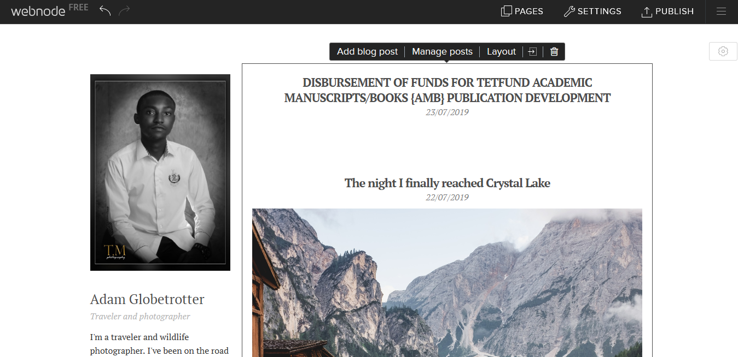
ICT/INNOVATION CENTER, UNN STEP 4:TOadd post, click on “add blog post”

Slide 12
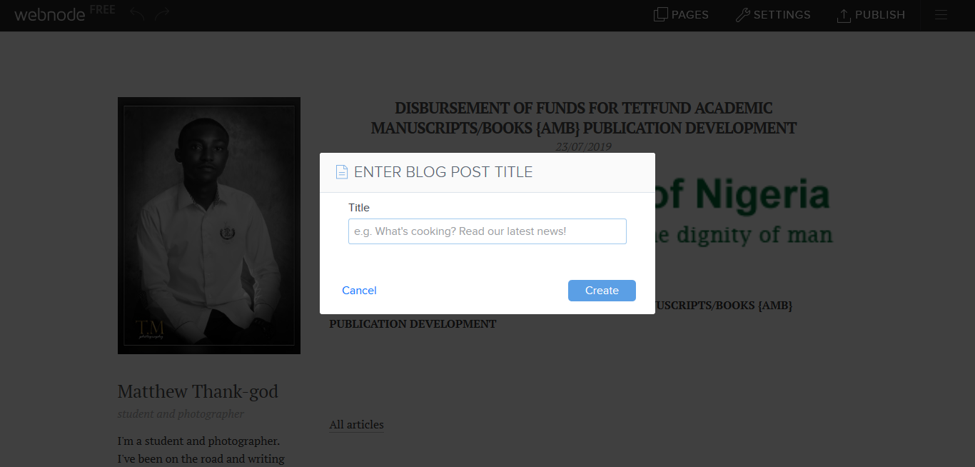
ICT/INNOVATION CENTER, UNN To post, add a title to your blog post.

Slide 13
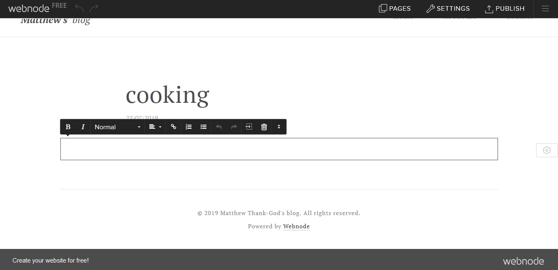
ICT/INNOVATION CENTER, UNN you can now start by adding pictures and links to your post

Slide 14
ICT/INNOVATION CENTER, UNN that is how to run a webnode blog; you can as well explore on your own.

Slide 15
UNIVERSITY OF NIGERIA, NSUKKA OFFICE oF THE VICE CHANCELLOR ICT/INNOVATION CENTER
THANK YOU

