Slide 1
UNIVERSITY OF NIGERIA, NSUKKA OFFICE oF THE VICE CHANCELLOR ICT/INNOVATION CENTER
TUMBLR CREATION STEPS
By
Webometrics Section
ICT UNIT
UNN

Slide 2
ICT/INNOVATION CENTER, UNN
STEP 1: TYPE THE URL “tumblr.com”
TYPE IN THE URL “www.tumblr.com”

Slide 3
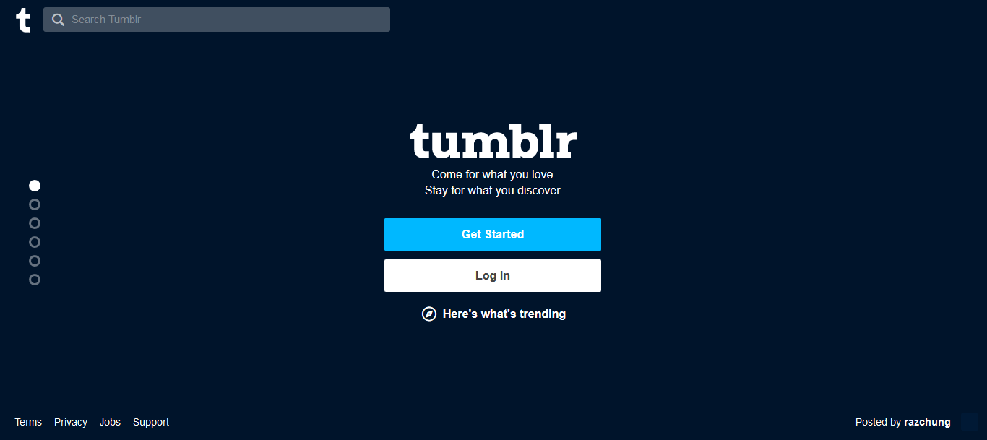
ICT/INNOVATION CENTER, UNN STEP 2: CLICK ON Get Started
Click on “Get Started”

Slide 4
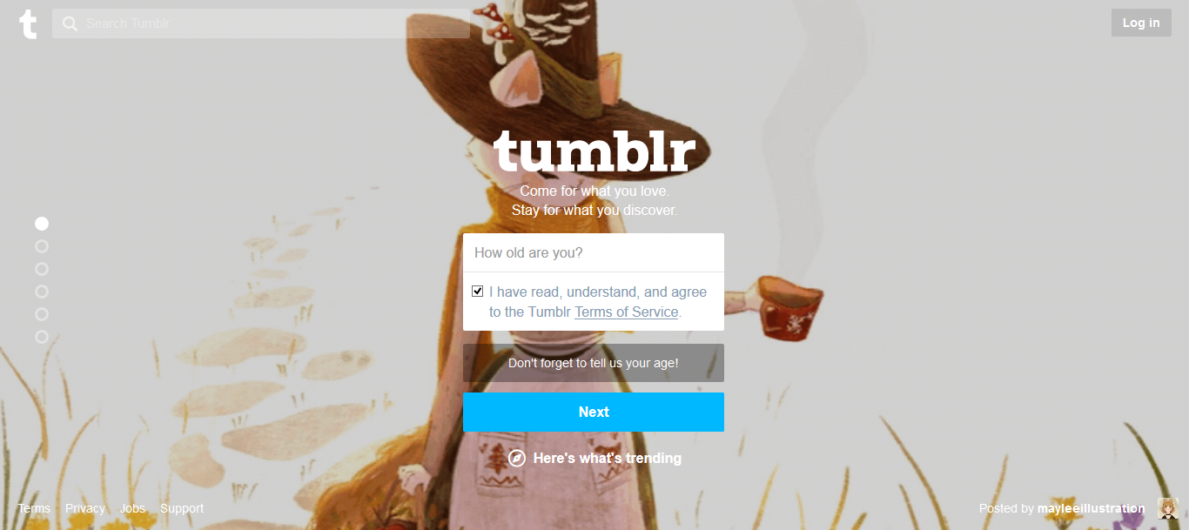
ICT/INNOVATION CENTER, UNN STEP 2: complete the information
After completing your information, make sure you TICK “terms of service”

Slide 5
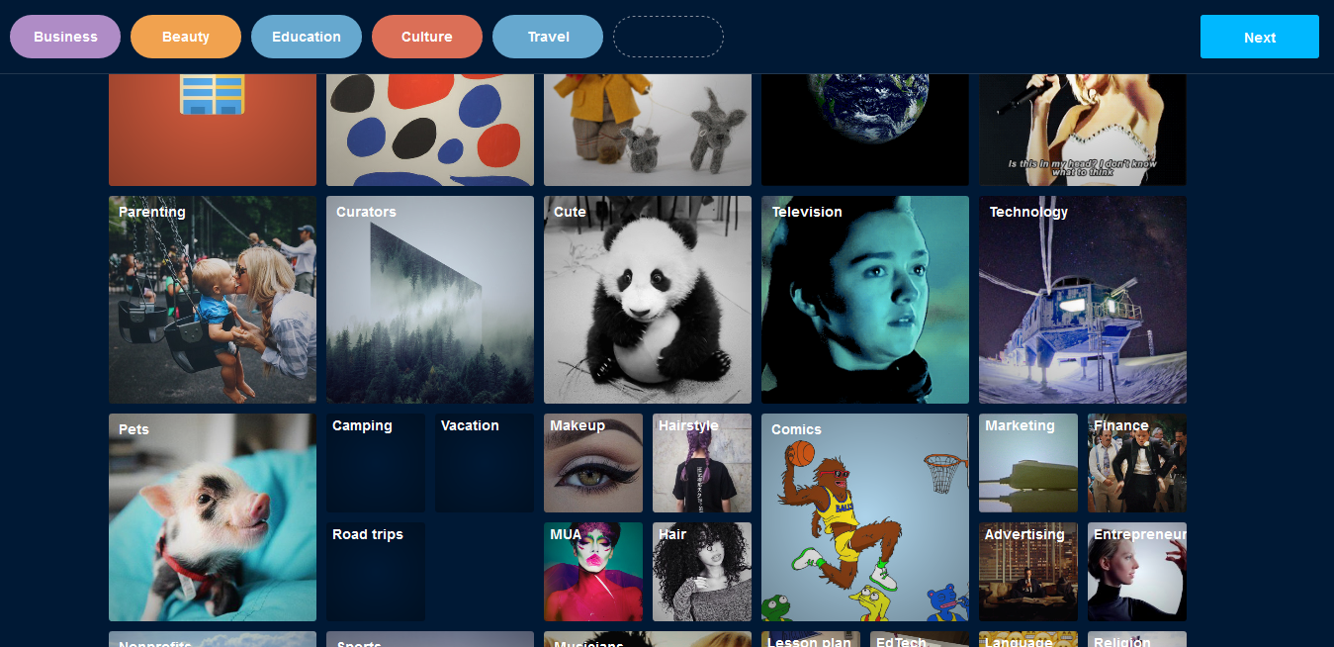
ICT/INNOVATION CENTER, UNN STEP 3: select the field you want to specialize on.

Slide 6
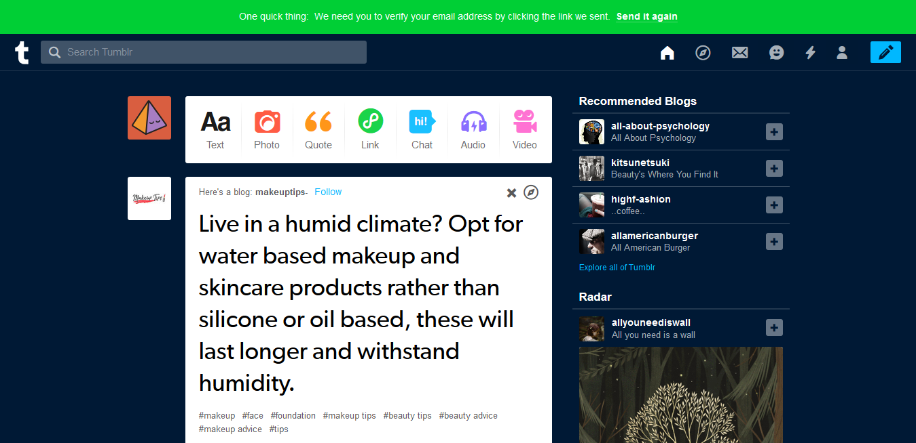
ICT/INNOVATION CENTER, UNN STEP 4: verify your account by clicking “send it again” above the page.

Slide 7
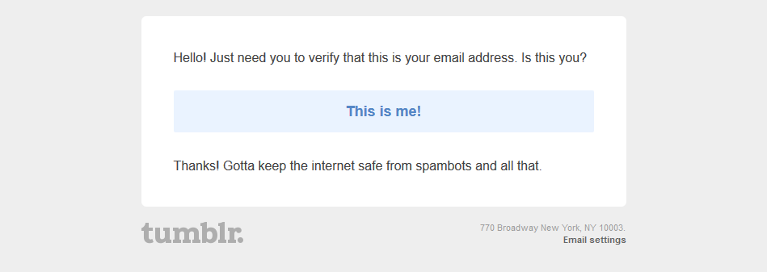
ICT/INNOVATION CENTER, UNN STEP 5: then go back to your mail and verify your account by clicking “this is me”.

Slide 8
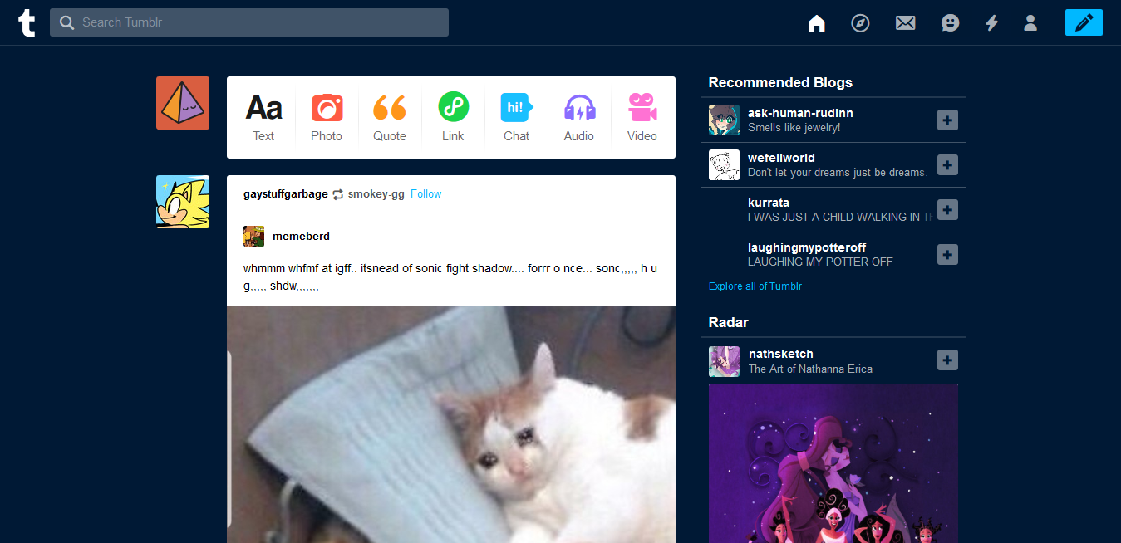
ICT/INNOVATION CENTER, UNN STEP 6: features “tumblr is very easy to use”

Slide 9
ICT/INNOVATION CENTER, UNN STEP 7: the text is to write what’s on your mind

Slide 10
ICT/INNOVATION CENTER, UNN STEP 13:COPY some of the content as shown below, Go back to the blog

Slide 11
ICT/INNOVATION CENTER, UNN STEP 4:TOadd LINK to YOUR POST 1. CLICK ON THE LINK ICON 2: TYPE THE LINK TEXT, 3. CLICK Add link

Slide 12
ICT/INNOVATION CENTER, UNN To post audios or videos, click on the audio or video icon

Slide 13
ICT/INNOVATION CENTER, UNN that’s is all you need to get started on tumblr

Slide 14
UNIVERSITY OF NIGERIA, NSUKKA OFFICE oF THE VICE CHANCELLOR ICT/INNOVATION CENTER
THANK YOU

