Slide 1
UNIVERSITY OF NIGERIA, NSUKKA OFFICE oF THE VICE CHANCELLOR ICT/INNOVATION CENTER
SITE123 CREATION STEPS
By
Webometrics Section
ICT UNIT
UNN

Slide 2
To get started on SITE123, go to “google.com” on your web-browser
Search for “Site123.com”

Slide 3
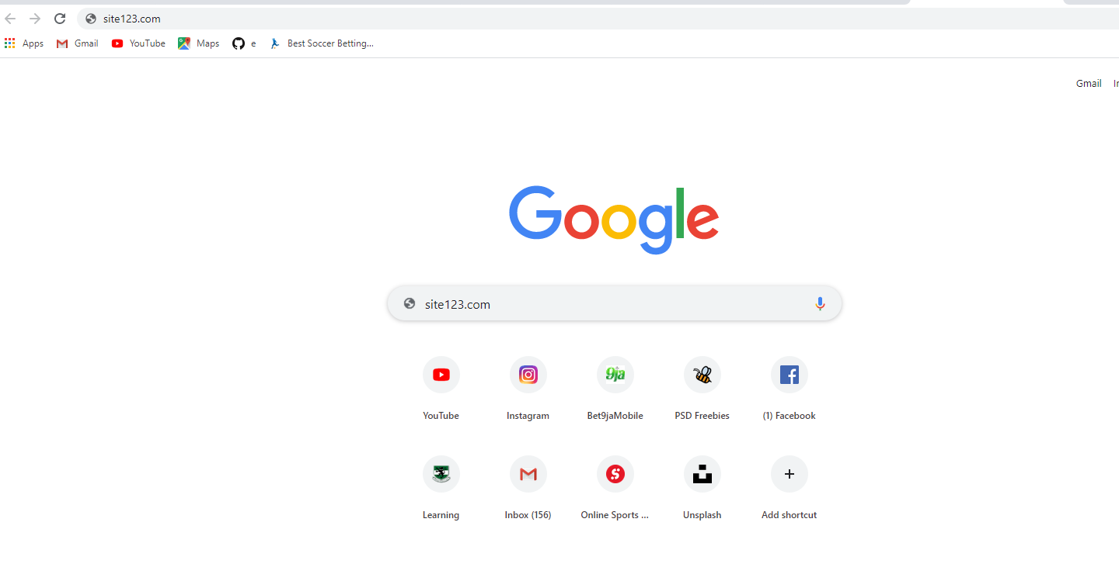
ICT/INNOVATION CENTER, UNN
STEP 1: TYPE THE URL “site123.com”

Slide 4
ICT/INNOVATION CENTER, UNN STEP 2
Click on “START HERE” and then its will take you to the next stage

Slide 5
ICT/INNOVATION CENTER, UNN STEP 3: CLICK ON “BLOG”
Click on “Get Started”

Slide 6
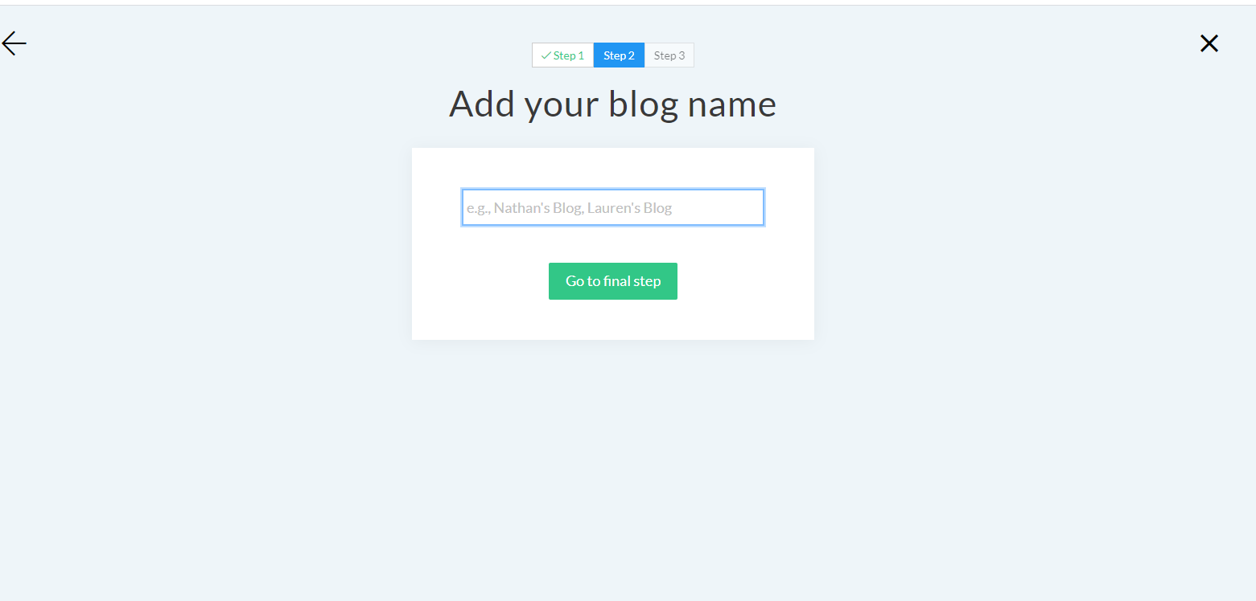
ICT/INNOVATION CENTER, UNN STEP 4
In this stage, you’ll be required to add your blog name.

Slide 7
ICT/INNOVATION CENTER, UNN STEP 5: complete the information
After completing your information, make sure you read the “terms of service”
After completing your information, the click on “Start my website”

Slide 8
ICT/INNOVATION CENTER, UNN STEP 6: click on “start building your website” to continue

Slide 9
ICT/INNOVATION CENTER, UNN STEP 7: verify your account by going to your Email and click on the link you received.

Slide 10
ICT/INNOVATION CENTER, UNN STEP 8: features; “site123” is very easy to use

Slide 11
ICT/INNOVATION CENTER, UNN STEP 9: the text is to write what’s on your mind

Slide 12
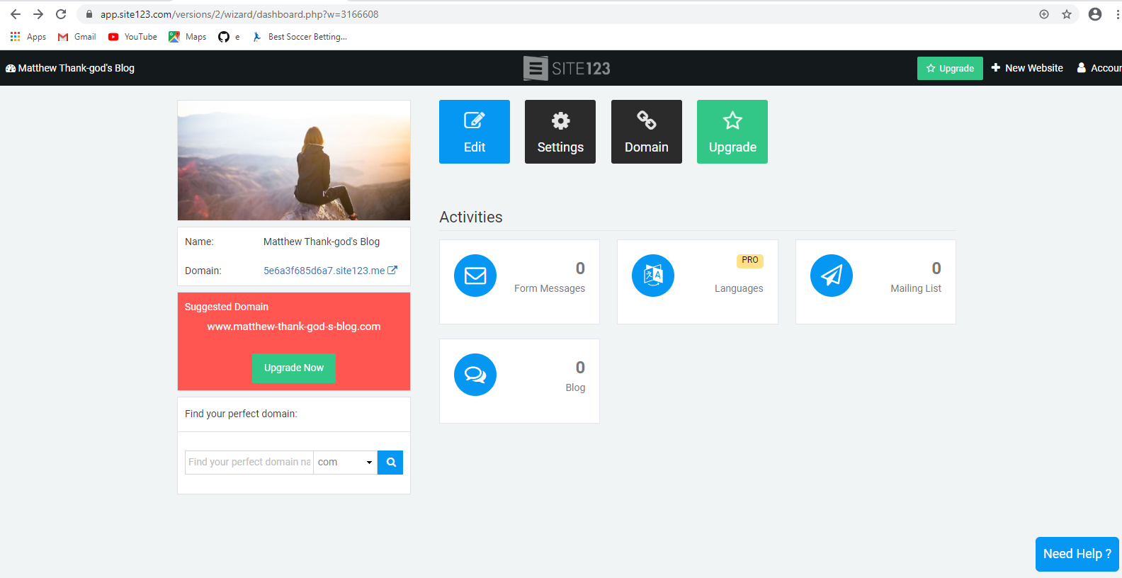
ICT/INNOVATION CENTER, UNN STEP 10: you could as well get an homepage just like this.

Slide 13
ICT/INNOVATION CENTER, UNN STEP 11: how to make a post on site123.
Click on Blog
Go to post
Add new post
Give it a title

Slide 14
ICT/INNOVATION CENTER, UNN STEP 12:click on blog.

Slide 15
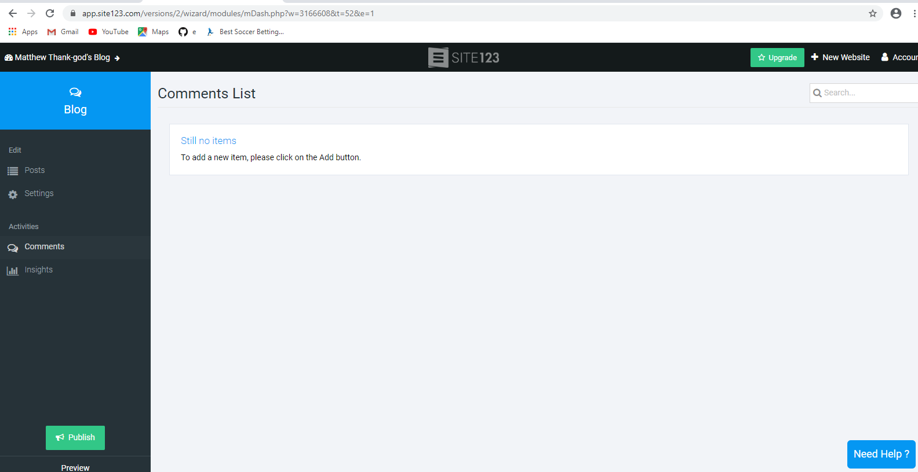
ICT/INNOVATION CENTER, UNN STEP 13:click on blog.

Slide 16
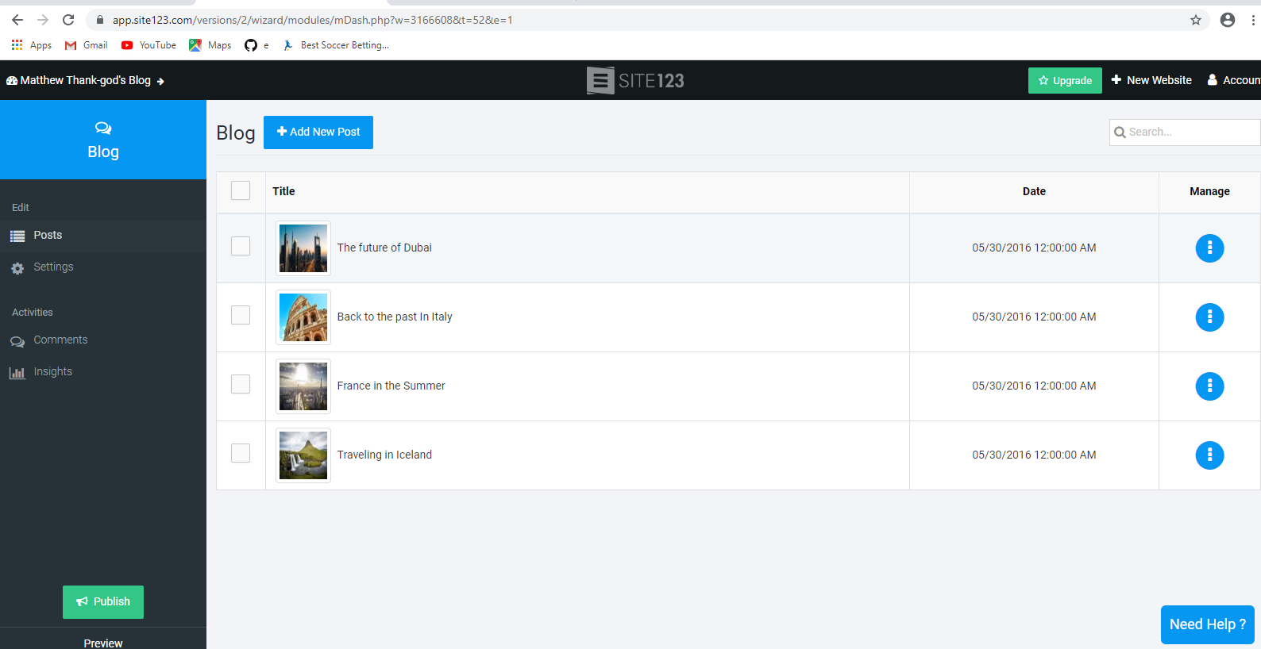
ICT/INNOVATION CENTER, UNN STEP 14:click on ‘add new post’.

Slide 17
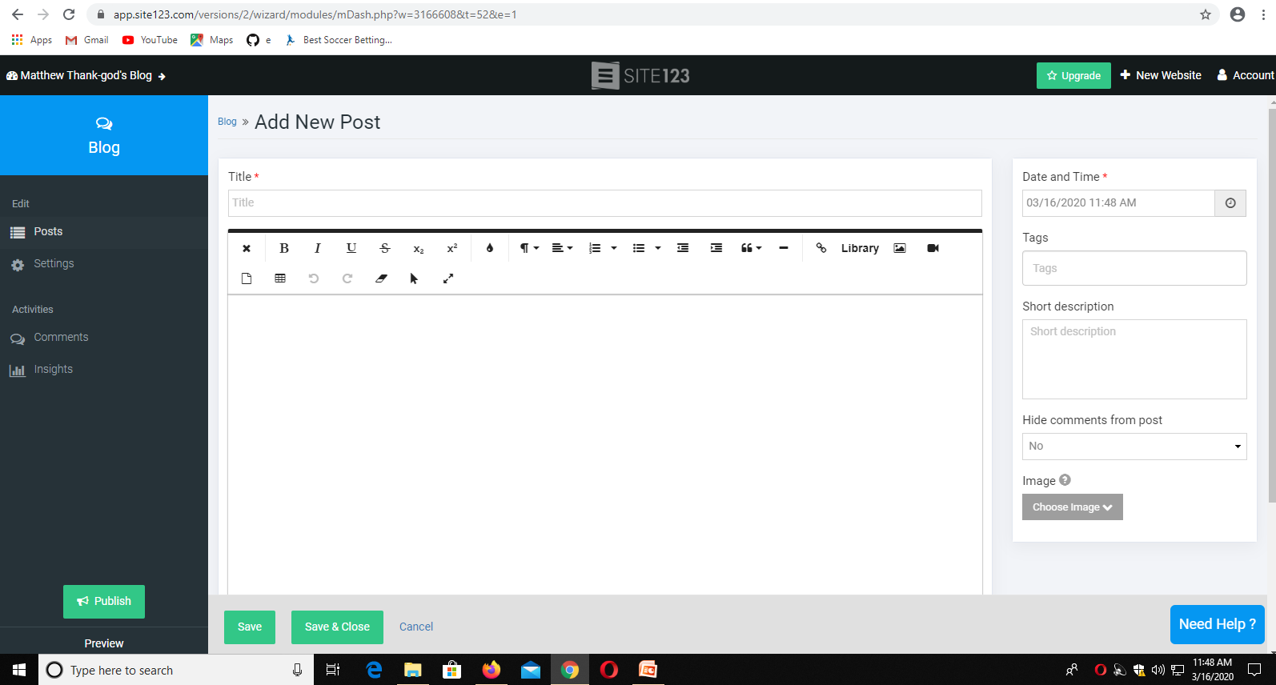
ICT/INNOVATION CENTER, UNN STEP 15:click on blog.

Slide 18
ICT/INNOVATION CENTER, UNN STEP 16:TOadd LINK to YOUR POST
HIGHLIGHT WHAT YOU WANT TO LINK
CLICK ON THE LINK ICON
TYPE THE LINK TEXT
CLICK Add LINK

Slide 19
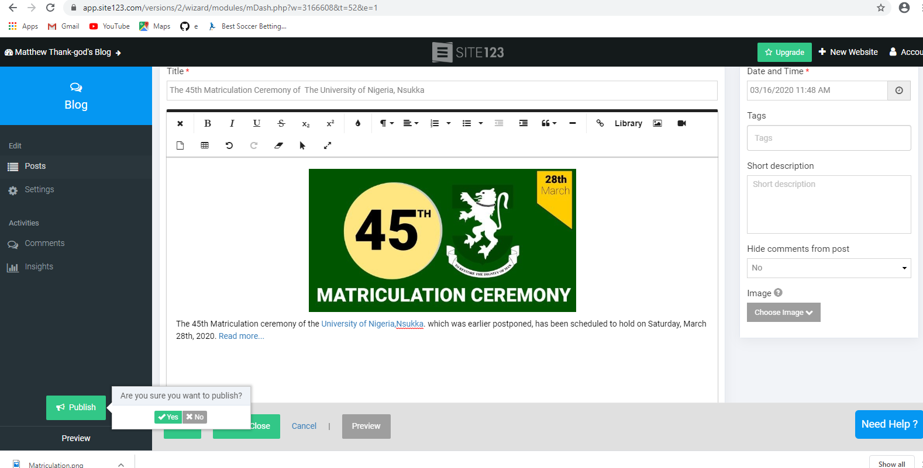
ICT/INNOVATION CENTER, UNN HERE IS AN EXAMPLE OF A BLOG POST

Slide 20
UNIVERSITY OF NIGERIA, NSUKKA OFFICE oF THE VICE CHANCELLOR ICT/INNOVATION CENTER
THANK YOU

